Slide 1
Results 11/10/24 Results 22+23/10/24
I will mix between these measurement days, since I will focus on the different topics in the analysis.

Slide 2
What was measured?
11/10/24: Array 128x0.5x0.5 mm²
y-translation through undiffused beam for normalisation under difficult circumstances?
Multiple pictures of undiffused beam, and the 3 diffusers with Gafchromic scans afterwards for comparison
New Bragg wedge out of PEEK material – combined with different energies from Al foil wheel
9 scans of undiffused beam over 1 hour
After second scan of beam there was a crash of the array into the metal parts of the proton outlet (likely to due tilt of stage from touched stage connction cables). We saw a saturated current, luckily there was NO! fatal damage to any diode or to the readout circuit. If some properties of either of those changed is of course not directly clear and will be investigated.

Slide 3
11/10/24: matrix 11x11 1x1 mm² #1
Voltage scans
x and y-translation to diffused beam
xy scan of beam to puzzle into one picture (with less time requirement than scan of linear array)
movie scan of beam (with fixed position, but several changes of the beam during the one long scan ~1500 frames over ~ 20 minutes)

Slide 4
21/10/24: matrix 11x11 0.5x0.5 mm² #1
Voltage scans + voltage dependent linearity
y-translated scan
xy scans of round aperture and star of misc shape with steps of half the diodes size for super-resolution
movie scan of beam over lunch (unchanged beam) + Gafchromic
scans of middle of undiffused beam at different proton energies from wheel (7 energies from 23.7 to 3.5 MeV) – what changes in terms of signal to noise ratio? What can we learn about our energy resolution?
y-translation after all these measurements
linearity afterwards
image of the misc star at the 7 chosen wheel positions – image quality in energy dependence
PEEK wedge for all 20 wheel positions with y-scan
21/10/24: array 2x64 0.5x0.5 mm² #1
PEEK wedge for all 20 wheel positions (stationary)

Slide 5
22/10/24: array 2x64 0.5x0.5 mm² #1
voltage scans
y-translation for normalization
linearity in voltage dependence
Gafchromic comparisons of: all three diffusers (40, 200, 400 um); logo, misc, PEEK wedge, mouse-foot, undiffused beam
22/10/24: matrix 11x11 1x1 mm² #2
voltage scans
y-translation for normalization
movie of beam over lunch
movie with increased current (increase each 30 seconds, ~1fps, from 100 pA to 2 nA)
linearity test, voltage dependent
another 2 movies of undiffused beam with some live changed features
movie of the moved logo (sadly with some problems due to improvised change of the stage translation – more details later – but at least we filmed the crash of the stage)

Slide 6
Strange 50 Hz modulation only with diffuser

Slide 7
Some important remark
During the measurements with lower integration time with higher frame rate I observed some periodic pattern on the signal with samples) meaning on the time axis!
I found this behaviour afterwards for all measurement days when the beam was undiffused.
I will add comparisons for all measurement days.

Slide 8
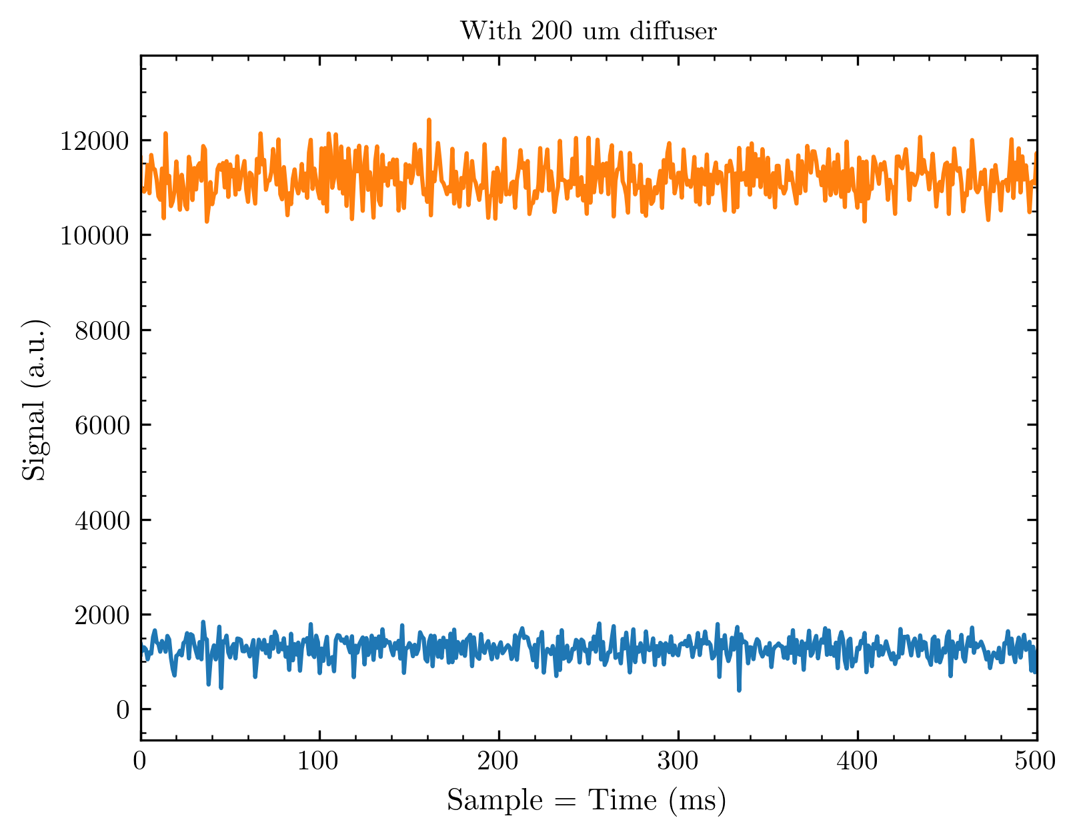
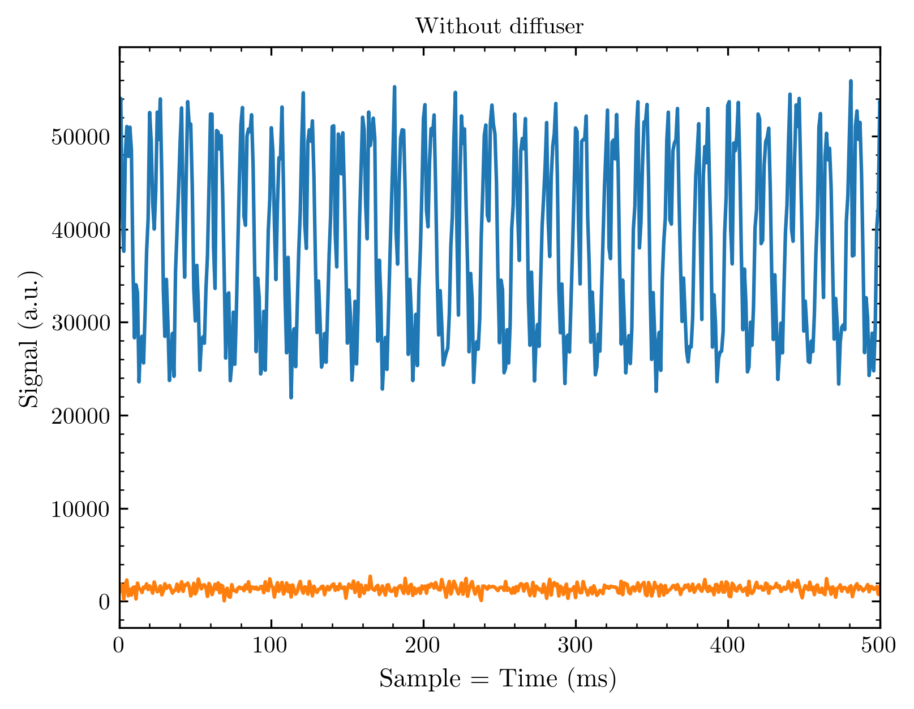
50 Hz noise on undiffused beam?!
Compared is the highest and lowest (dark) signal of arbitrary measurements with and without diffuser
I observed this modulation for different measurement days whenever we measured without diffuser; I will nevertheless bring these observations in plots for you to compare
If you count the periods on the right side you find: 10 periods in 200 ms meaning 50 in 1s = 50 Hz…

Slide 9
Where could this come from?
We first thought about the readout electronics, but this is not explaining why we observe only without diffuser
The Cyrcé guys thought about a pump and a mechanical vibration – it was not the cause and would also not explain the diffuser behaviour
Obviously the fact that the modulation disappears when the diffuser is in the beam is really odd
(I started the following thought: A diffuser should compensate for the time modulation of a proton beam because it changes the trajectories of incoming protons. You can continue the thought and if this would imply something for the undiffused proton beam at Cyrcé…)

Slide 10
Important report from 11/10/2024: Crash of diode array with metal surroundings
Without any damage done from what I observed so far!

Slide 11
What happended
We measured with the 128x0.5x0.5 mm² linear array to create comparisons with Gafchromic, taken afterwards.
After BeamScan 01, a Gafchromic was taken (for this, the whole stage with the array is shifted away to allow a camera view of the Gafchromic). The array was repositioned afterwards; as usual.
Most likely, the then-inserted beam block touched the connection cables of the XY-stages and thus tilted the whole stage with array towards the metal aperture.
We did not recognise this at first and started a measurement.

Slide 12
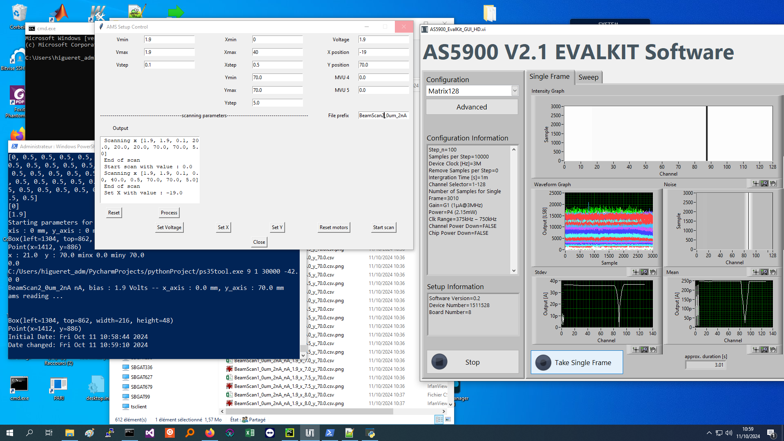
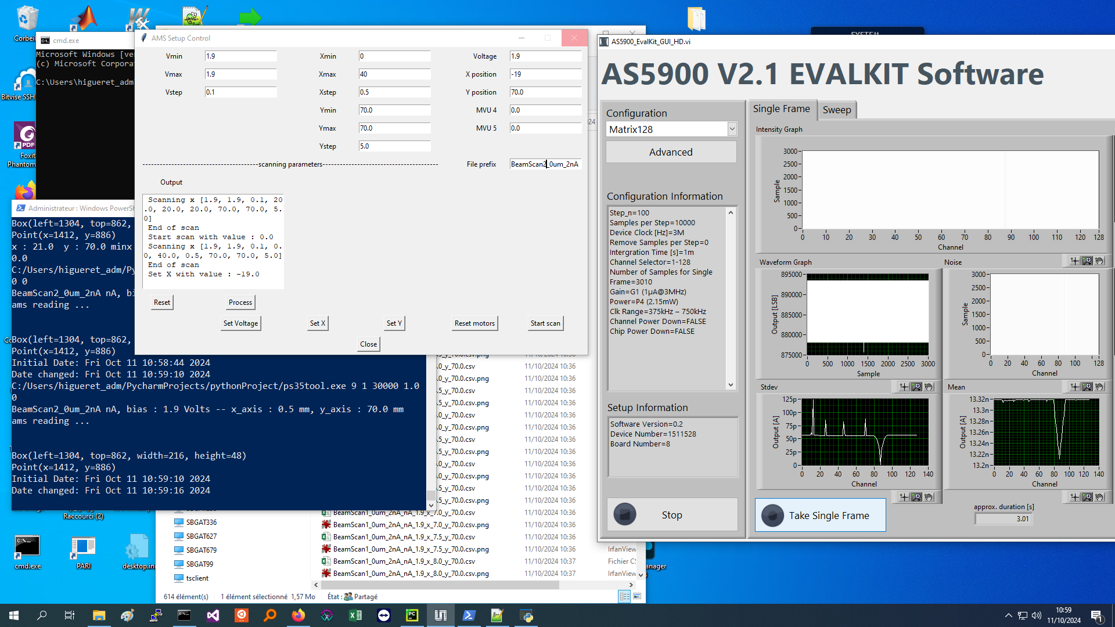
We observed this and immediately stopped!
This looks btw like the saturated channels at V < 0.5 V – channel 88 saturates earlier than the other channels. This does not have any further implications from what we have observed so far because we do not measure in the regime of saturation

Slide 13
The array, indeed, mechanically collided with the metal surroundings. We found no signs of damage with the bare eye. The dark signal checks afterwards also showed the same behaviour as before. So, we accidentally proved that the sealed bonding done in Strasbourg has excellent robustness. For your info (compare logbook): All measurements including ‘BeamScan02‘ were taken after this crash.

Slide 14
Possible defect of readout circuit
Short observation – channel 111 always had a higher signal, and channel 113 always had zero signal (means no detection, = 0 in data files)
This occured for all 3 different arrays measured on 21+22/10/2024. Both channels reacted as expected at the previous measurements from the 11/10/2024 (also after the touching between circuit and metal aperture)

Slide 15
For the last two measurement days, there were (as usual) some not working channels. Usually, they depend on the array.
If the channel number corresponds between different arrays, there might be some problems coming from the readout electronics (PCB card with connector lines, connector cables (but changed for each array?!), or in the worst case readout circuit (we only have one so far – until ~ next summer).
Exactly this happened for all measurements on 21+22/10/2024, I observed channel 111 with a higher signal (but linear response) and channel 113 with exactly 0 signal. (regardless which array was used 2Line, Large Matrix #2, Small Matrix #1, same behaviour without signal)
Thus we might have a problem with the readout circuit! I will see if channel 111 can be used (but I think so with normalisation) – while channel 113 was always dead from the readout side.

Slide 16
New voltage scan results

Slide 17
Some remarks
I made some mistake with the results I have shown earlier for the 128 diode line arrays!
The problem was: I considered all diodes, but we only had a part of these arrays in the beam
Thus, I wrote a new routine for voltage scans (since this is part of our standard characterisation of arrays) with implemented filter for signal diodes (this also excludes not properly working diodes)

Slide 18
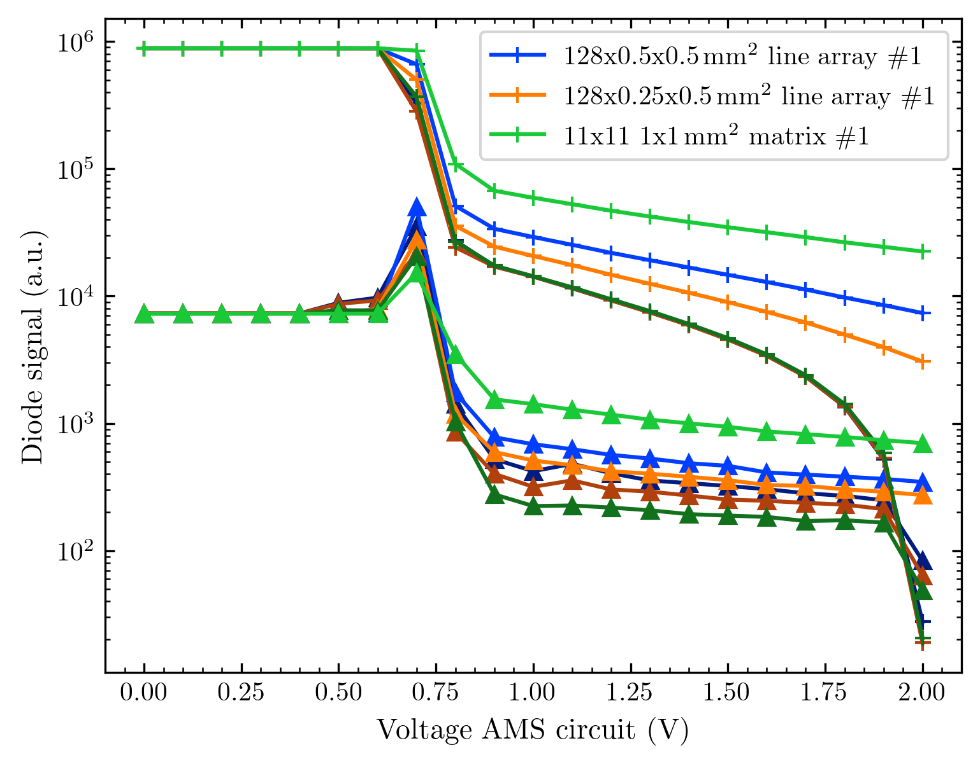
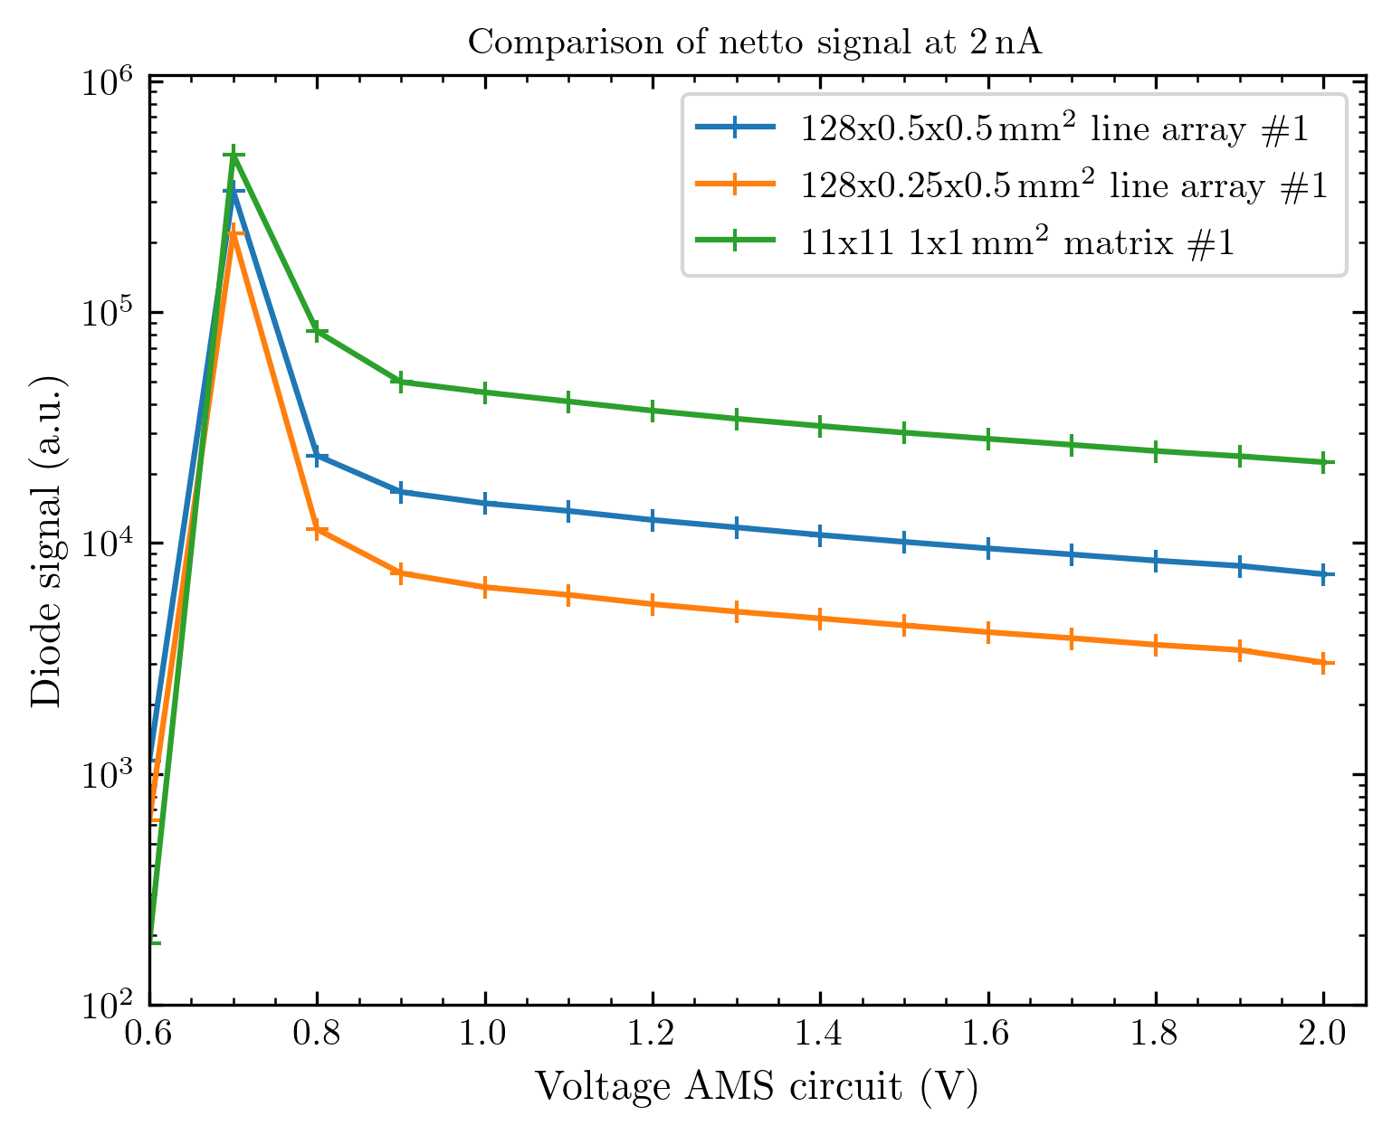
Voltage scan up to the 11th October

Slide 19
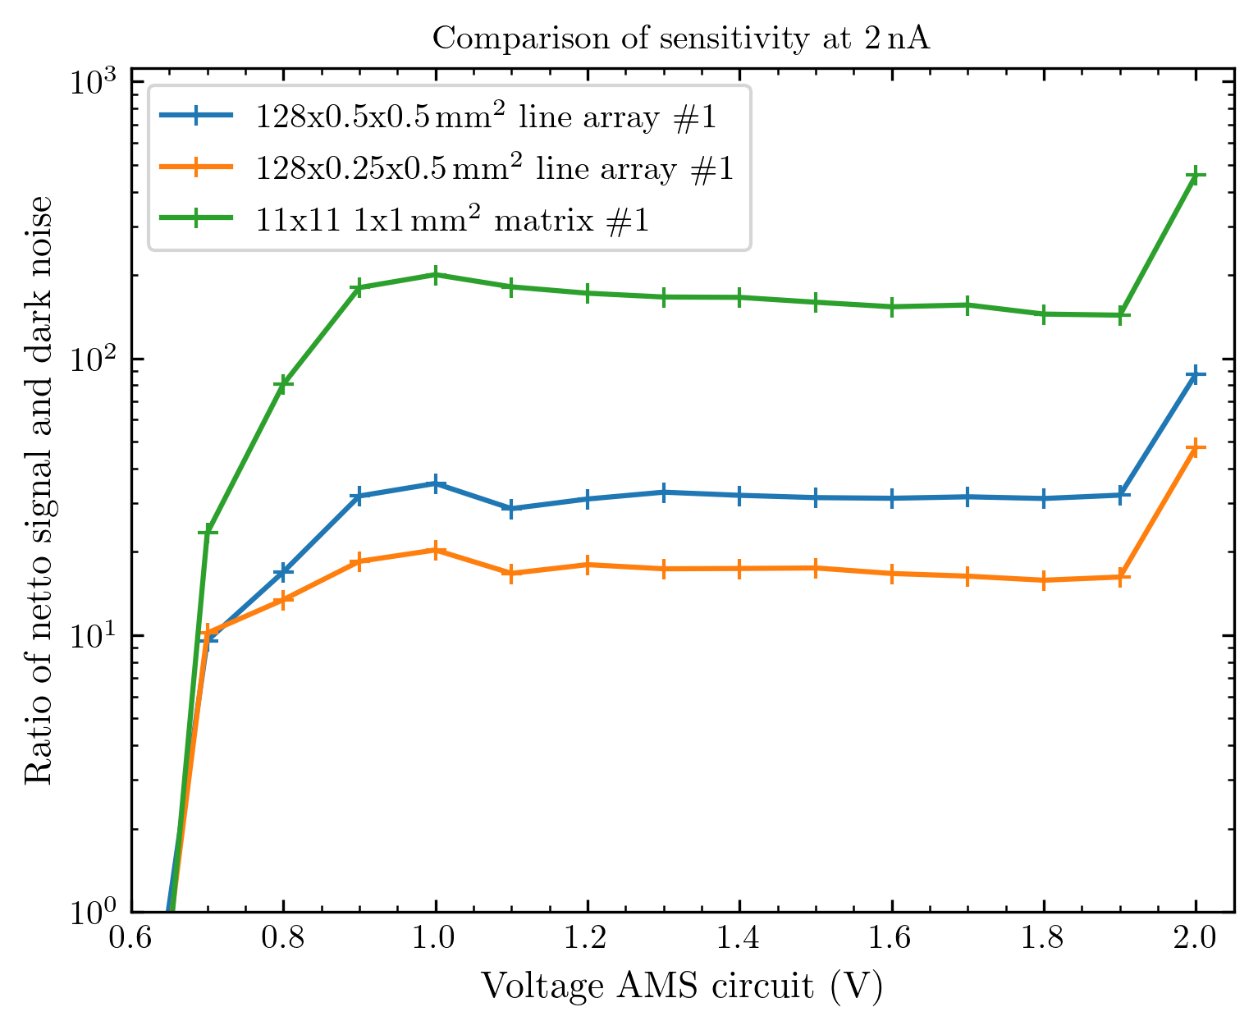
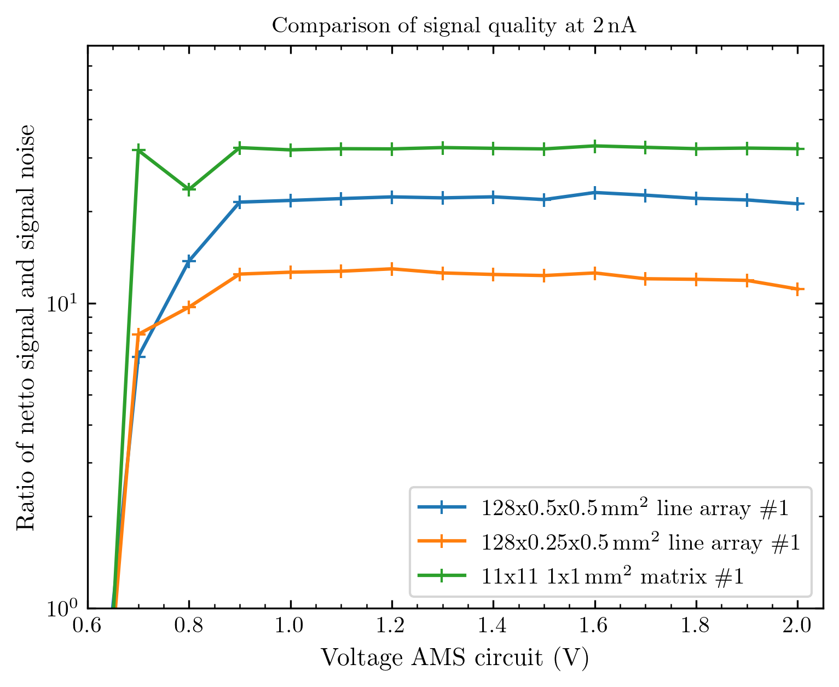
Sensitivity and signal quality

Slide 20
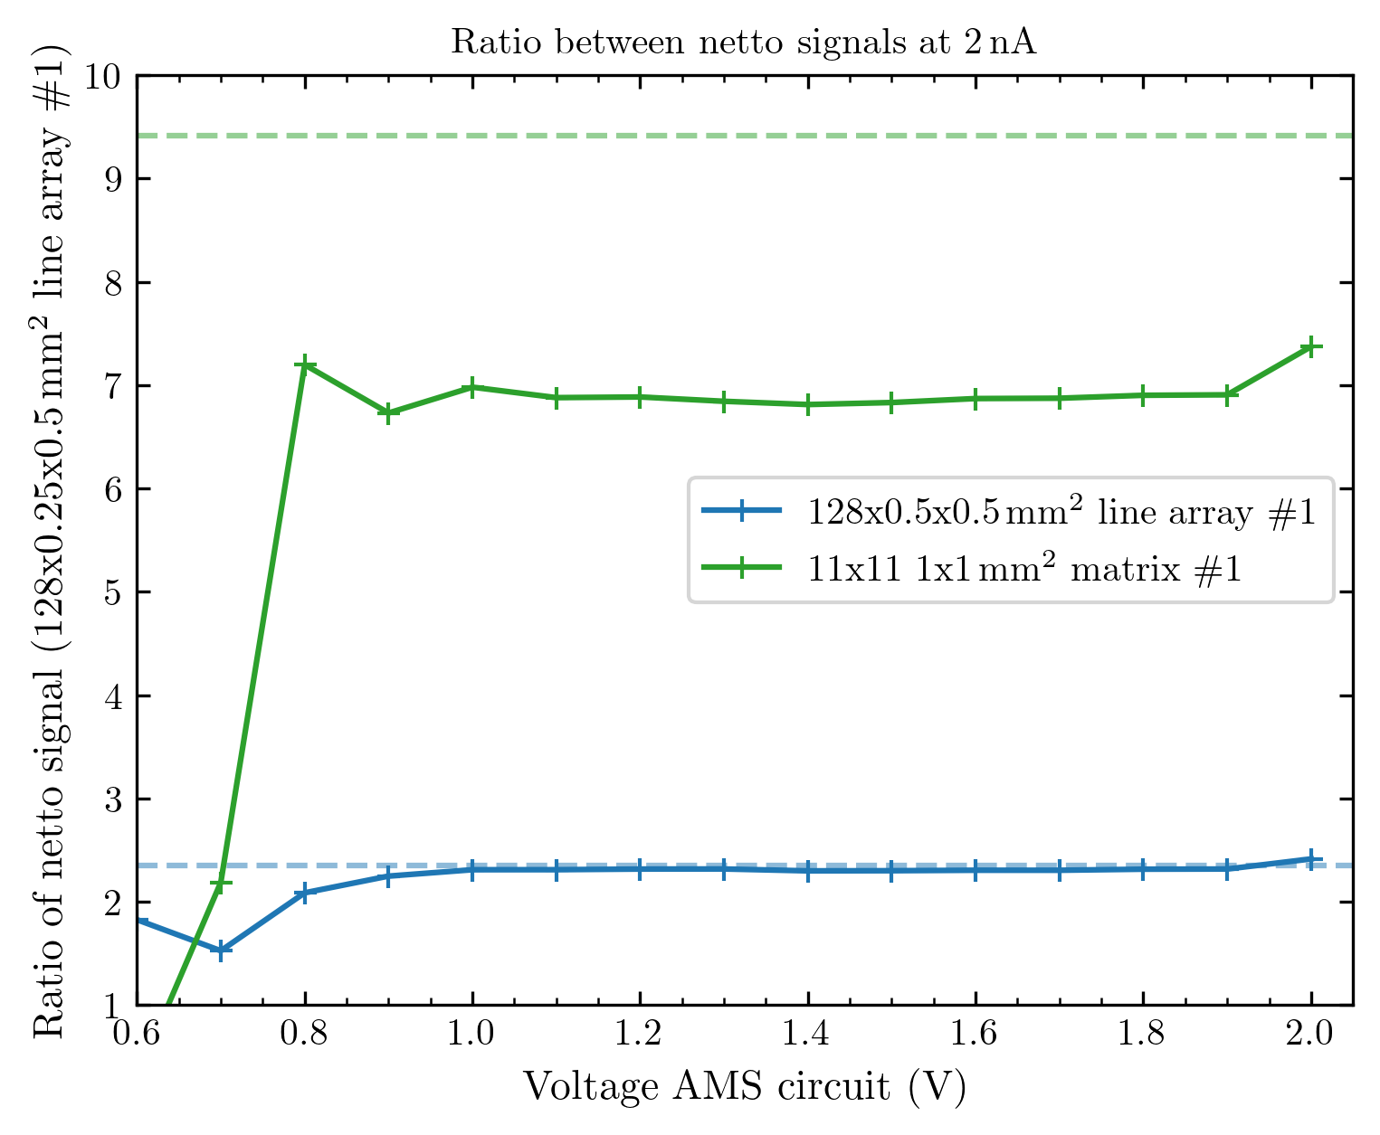
And most importantly the ratios!
These are the ratios normed to the smallest array (128x0.25x0.5)
A dashed line shows the caluclated ratio when considering the active region of the diodes (meaning 0.4 x 0.4 mm² for the 0.5 x 0.5mm² diodes)
These new results are remarkable and different from what I presented earlier. The new implication is: The detection seems to happen exactly in the region we intend it to happen!
For the matrix array, we observe a discrepancy from the estimated ratio, but I will explain later why this is not really comparable.

Slide 21
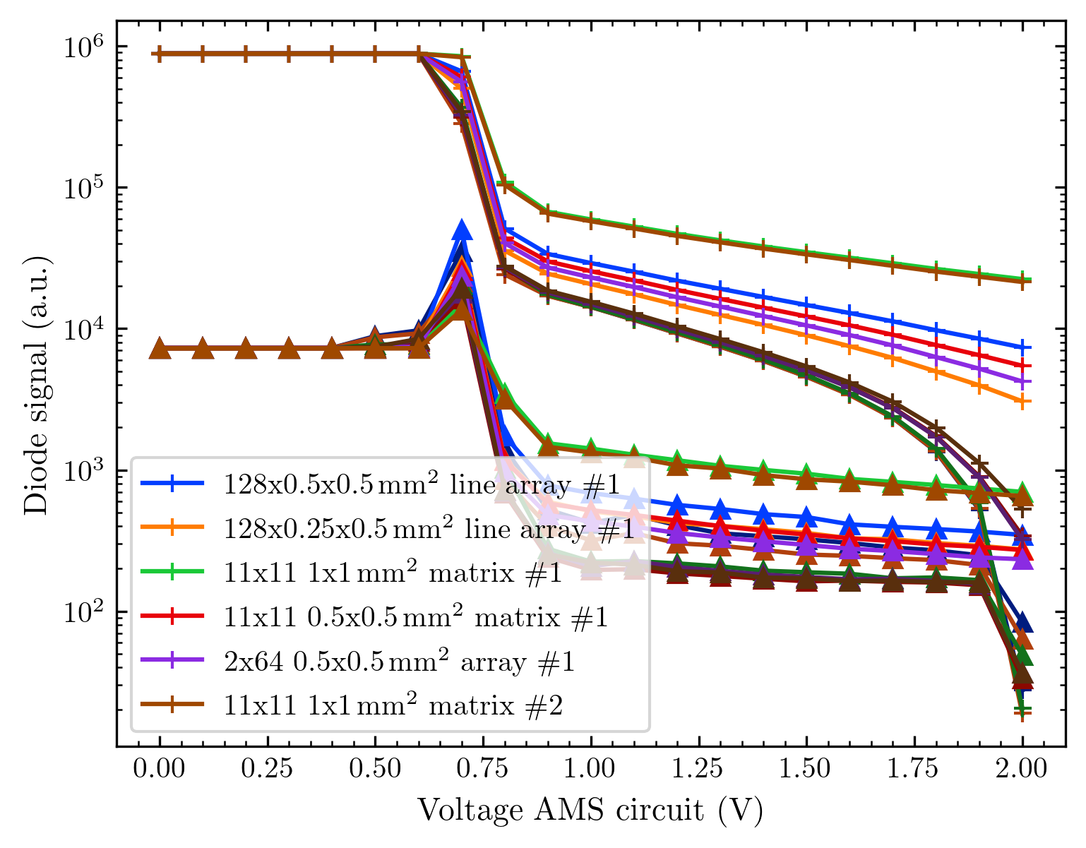
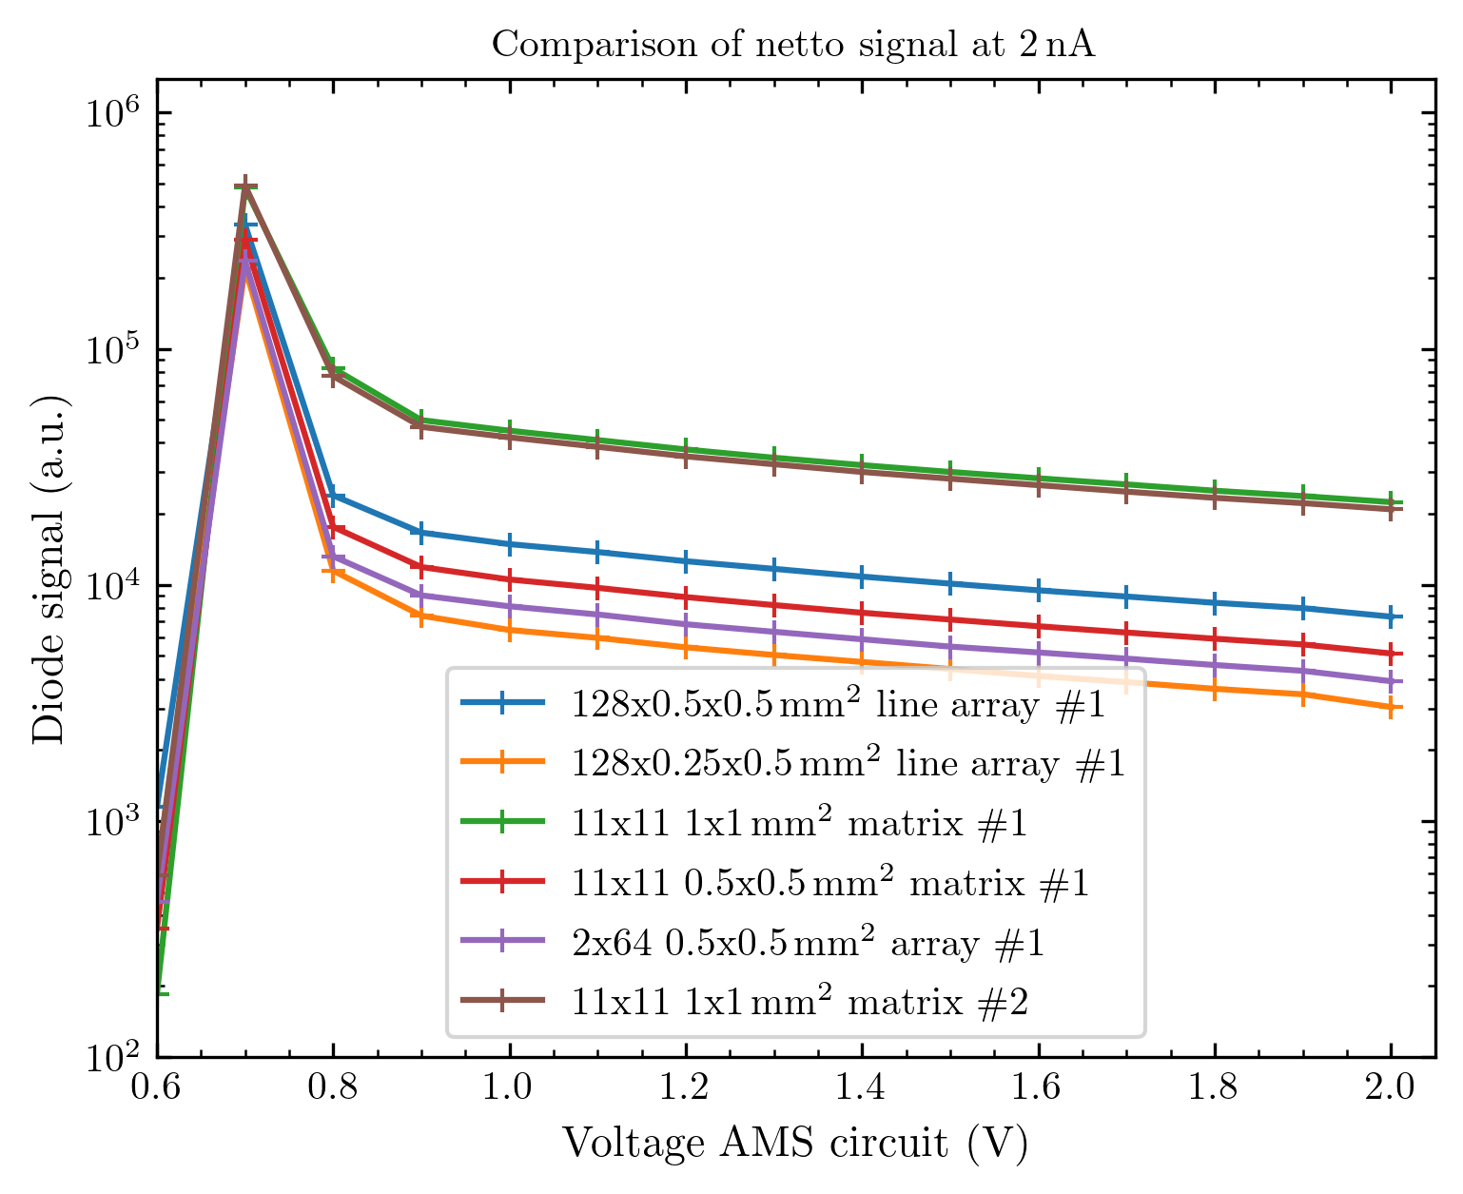
All voltage scans up to the 22nd of October

Slide 22
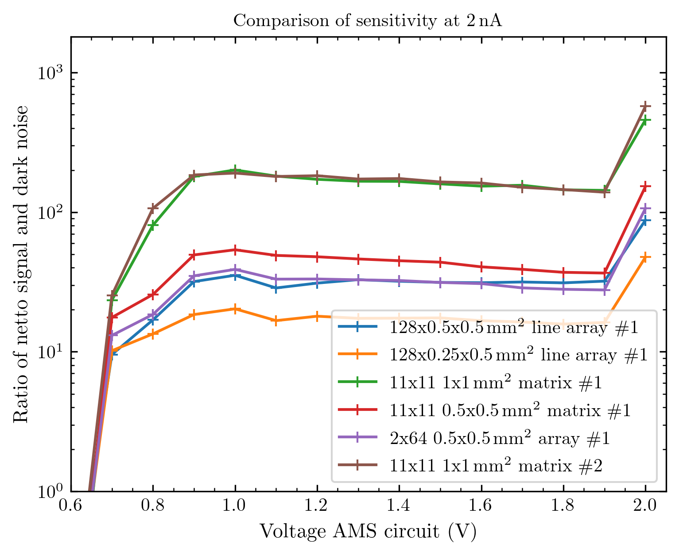
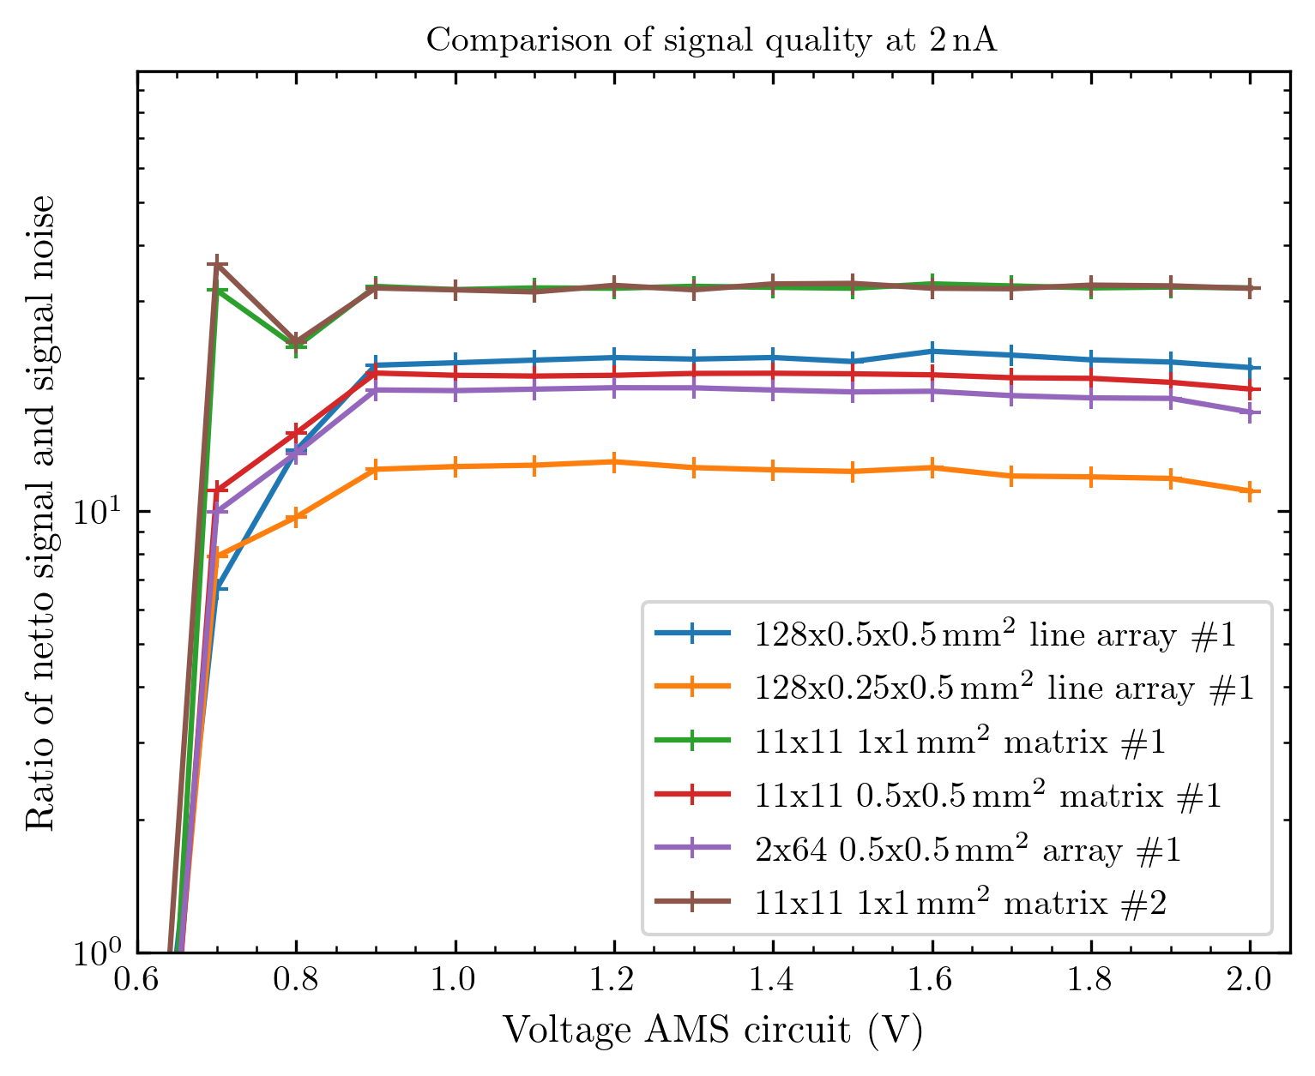
Sensitivity and signal quality
Note that the sensitivity implies that we could e.g. detect a current ~ 200 lower than we had for the big matrix arrays)
Meaning: 2 nA at Faraday cup / 200 = 10 pA at Faraday cup under these conditions for the large diodes.

Slide 23
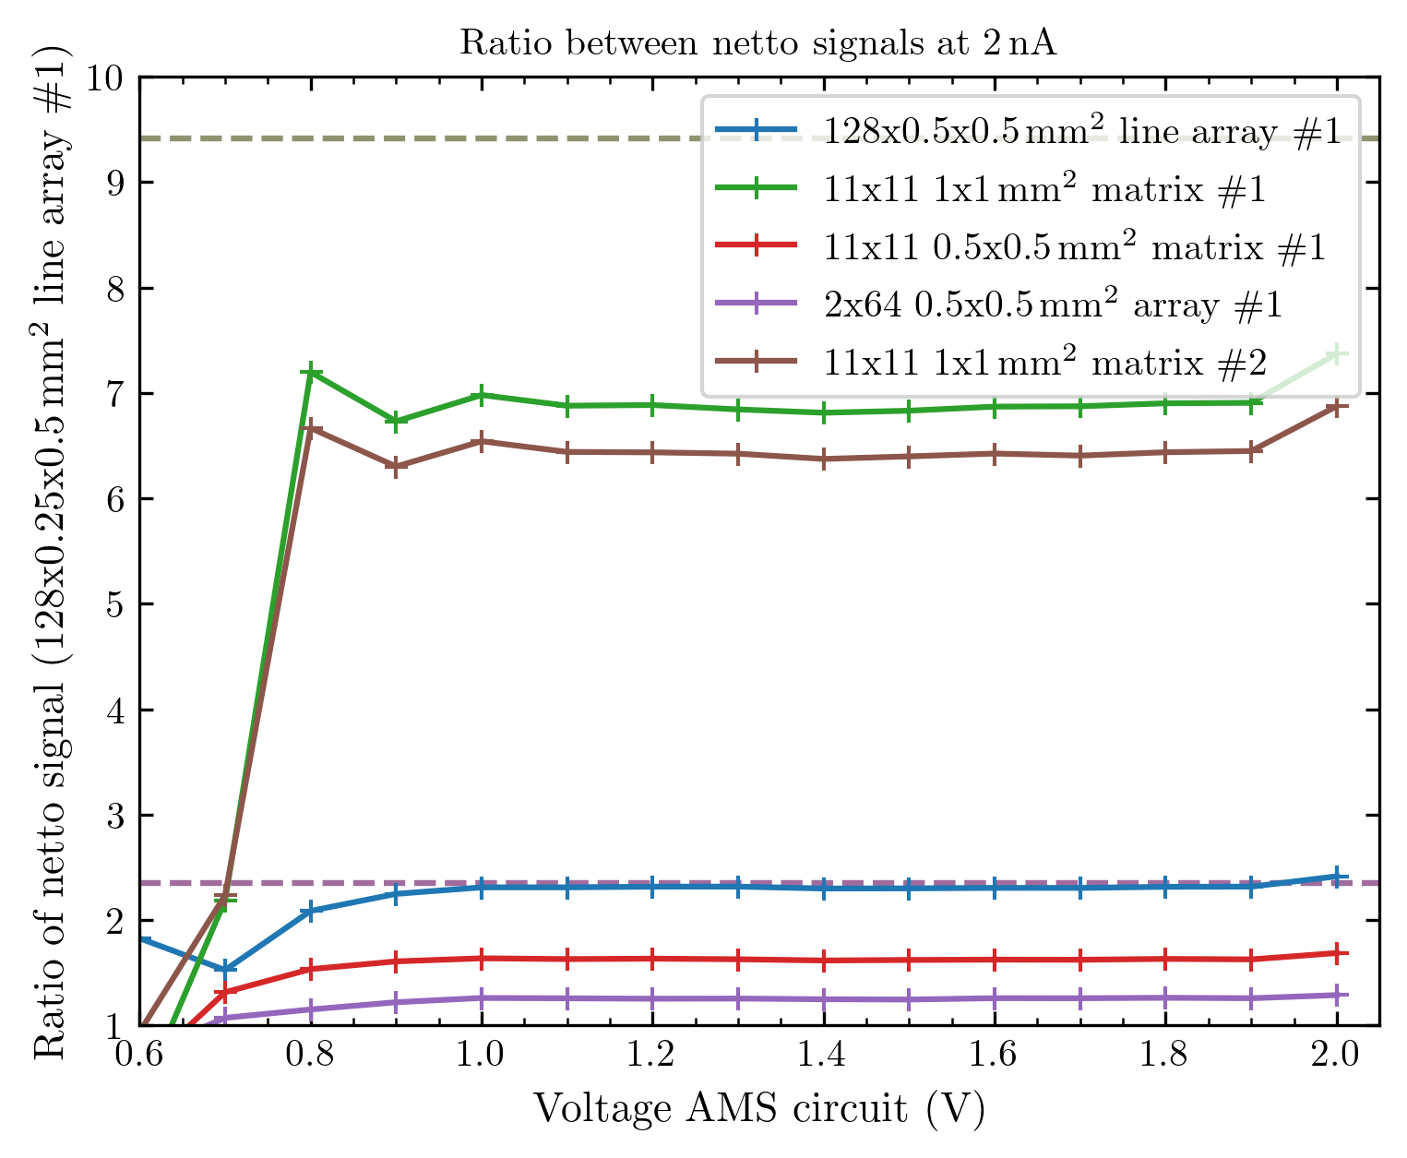
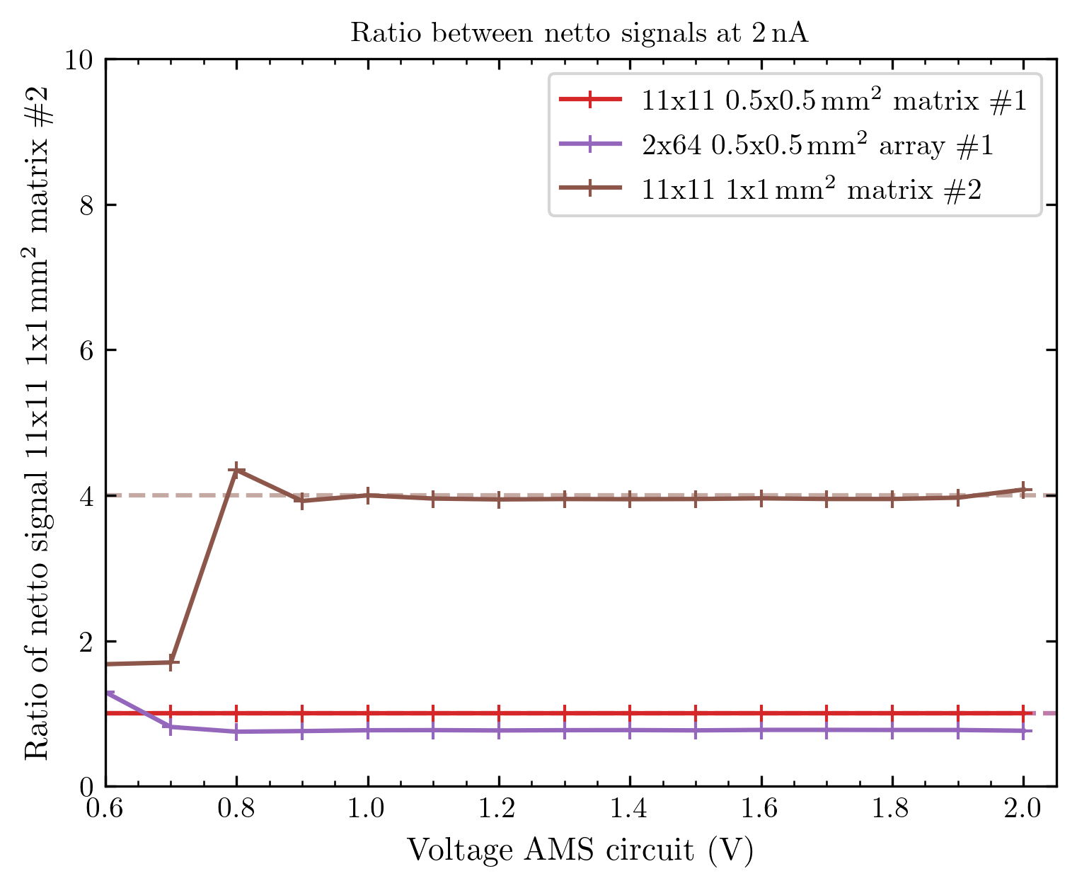
All ratios
All arrays normed to small 128x0.25x0.5 array, but conditions are not all comparable!
All new arrays from 21/22 = comparable, normed to small matrix.

Slide 24
Still not really correct
I wrote in the header of the plots @ 2 nA, but this is false
On the 23rd of September, we had 2.43 nA at Faraday cup to get 2 on the sample and the additional collimator
Afterwards, we kept 2 nA at the Faraday cup…
To make really correct plots, I need to correspond to the proton current we really had on each measurement day. So far, the info we got from the Cyrcé crew does not really fit, so I am waiting for further updates.

Slide 25
Movie time: logo and current increase
Speed by factor 20 increased to 20 fps.
If movies are not displayed correctly in PPT: I put them as .zip into the results folder

Slide 26
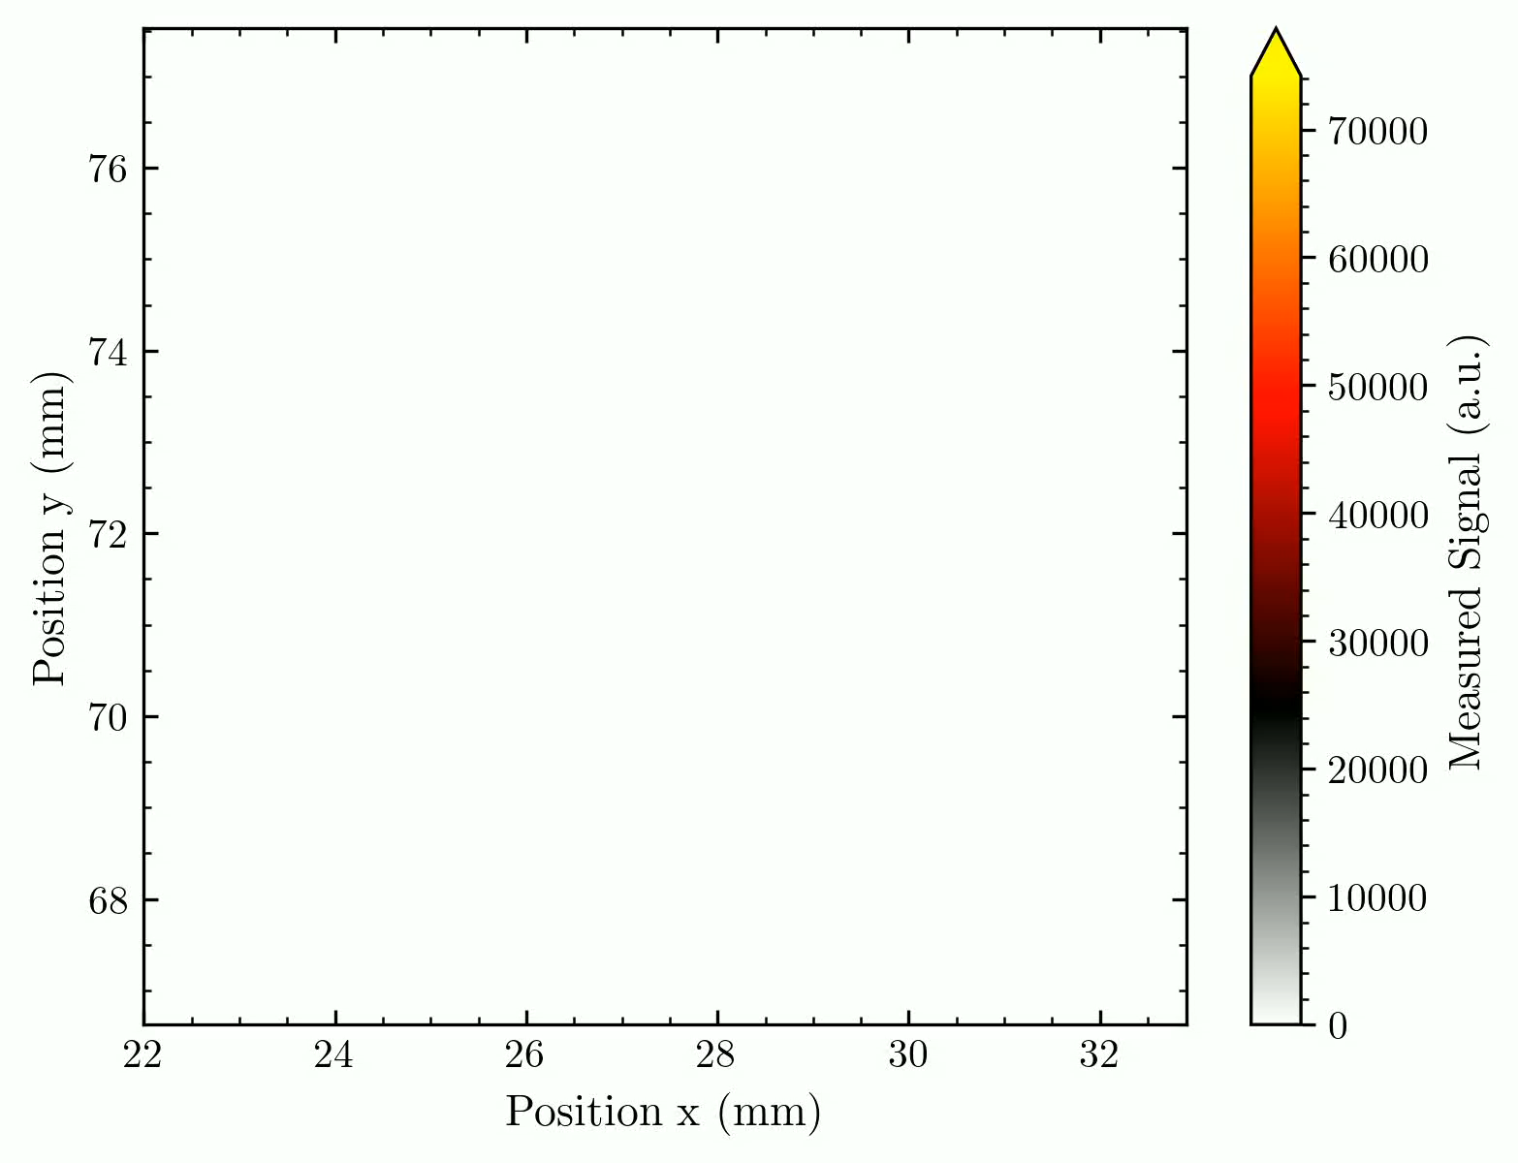
Movie current increase
Needs refinement, like normalisation and eventually filtering for uniform intensity scale
We used a square aperture shadowing the borders of the array.
The array is slightly tilted.

Slide 27
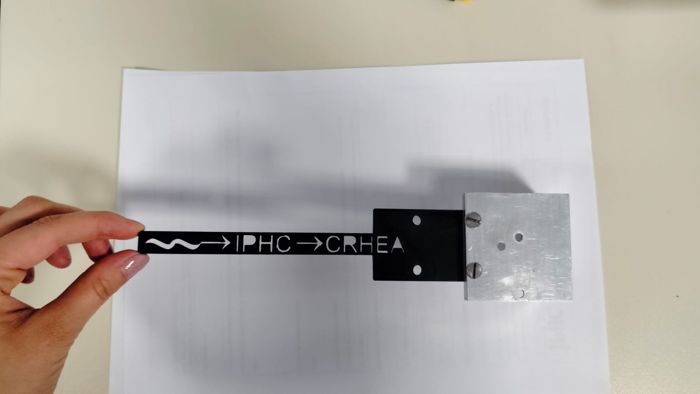
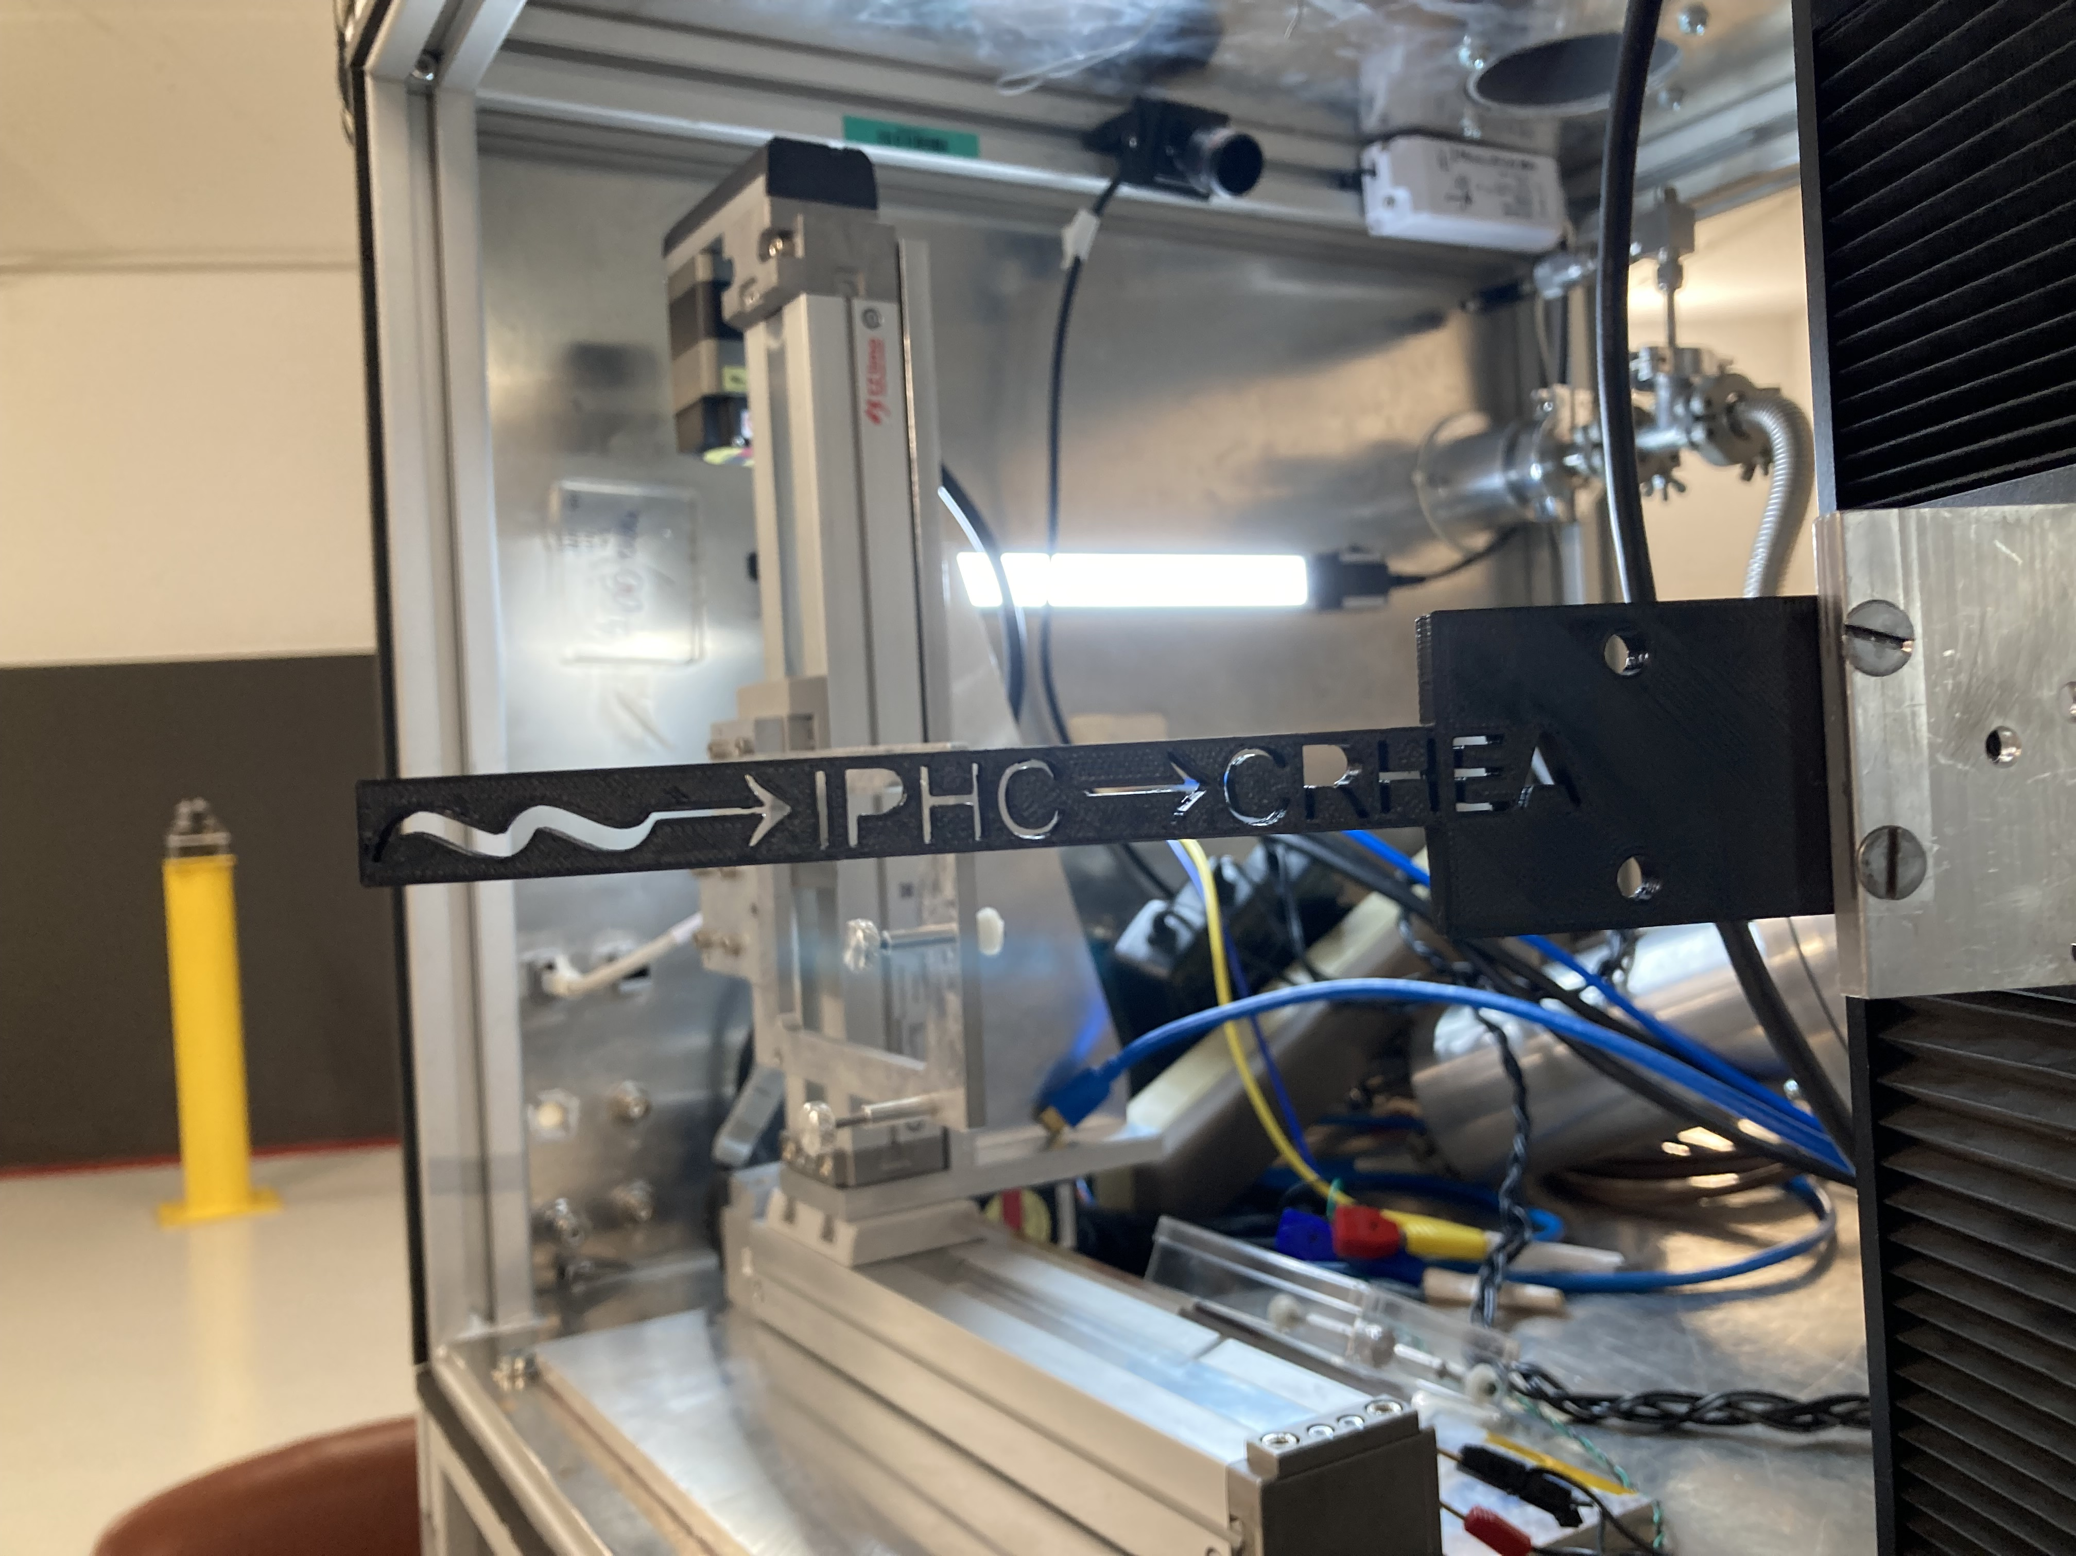
Movie Logo move
The following happened around/ during the movie:
Planned was an x-translation (photo) but this was not possible due to the extent of the linear stage over the vacuum box
The change to y-worked mechanically, but the code was not ready for it. Somehow the controller has a factor 2 on this y-axis stage, which was not considered.
From design the movie is reversed: Meaning we started with the end of the logo and ended the movement at the intended start of the movie.
Thus we started the linear movement far too late and moved far too wide with the y-stage.
We only have the IPHC fully in the movie, CRHEA is cut on the first letter (I will not interfere in this Strasbourg – Nice thing here ☺)
But the start of the movie shows (for a relatively long time) how the stage moved into the 2 limits and broke them… - live documented!

Slide 28
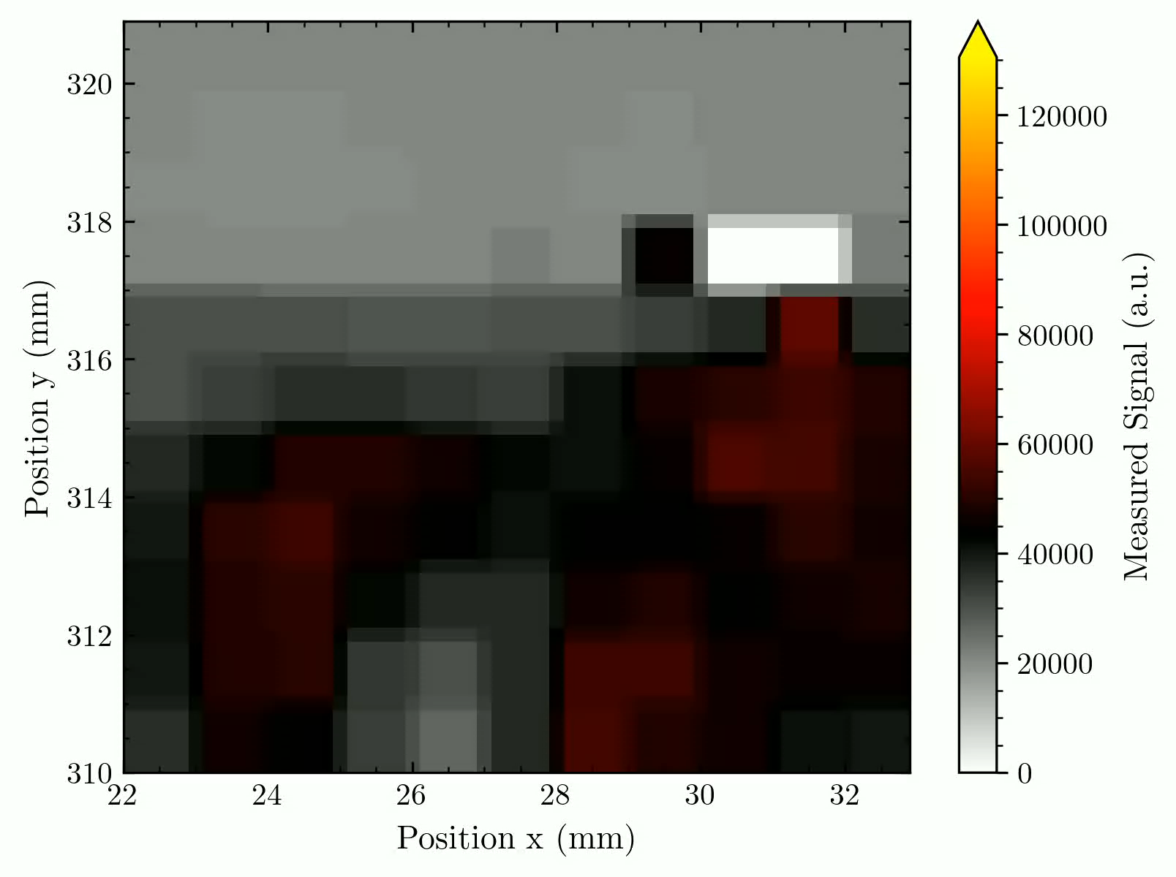
I still need to compensate for the not working pixels, normalize everything, and mirror the image (since it‘s false from this perspective).
Some other remark: The logo was too thin and thus did not absorb the proton beam. We thus have a contrast from red (protons with lower energy) to grey (open proton beam). And some density fluctuations in the logo make parts harder to recognize.

Slide 29
General remarks

Slide 30
General stuff
Logbooks will be scanned and made available for you.
We need to discuss conferences/papers, as we already talked about with Matilde, Maxime & Stéphane.

Slide 31


Some plot-style remarks (from your side?)
I can quickly change the colour scale, format, etc. , of my result plots (made with Matplotlib). So if you have some remarks or suggestions, … please let me know. Maybe we can discuss some uniform plot styles we use in the MATRIX project.
E.g.: I can put every colour scale for the intensity of our images/videos. I suggest some perceptually uniform scales as described by https://seaborn.pydata.org/tutorial/color_palettes.html
(I try to avoid the quite often used rainbow scale because of the green part that's recognised more by the eye.)
It is also possible to design any colour scale on our own by just handing Matplotlib the colours it should vary in between.
Some examples: These two are uniform and avoid light or dark shades that could vanish before a background.

Slide 32
Linearity
Standard process for analyzing
Results small and big matrix arrays 21+22/10/24
Is the voltage chosen impacting the linearity of our arrays?

Slide 33
What will be analyzed
We measured the linearity voltage-dependent for currents between 0.5 nA – 2.5 nA (5 points)
This is not the biggest range, but it is enough for some quick statements about the linearity of arrays (especially when collecting measurements as a benchmark for new arrays)
Again only diodes with signal will be considered! Signal = netto signal (signal –dark)
I will plot the mean signal of all diodes (black, x) and the signal of each diode (grey, x)
Also plotted: Dark noise (black, v); mean of signal std (blue, ^); std of diodes signal (green, ^)
I also show the inaccuracy of the mean signal = Sqrt[mean of signal std² + std of diodes‘ signal²] (black, ^)
I fit a linear function of type f(x) = a*x to each diode's response and collect their R² value – in the plot I will show the mean of these fits (red, -- line) and the mean of all R² values.
I also fit a function of type f(x) = a*x^{1/2} + (dark noise) to each signal noise, again I will show the mean (red, -- line) and the mean of all R² values.

Slide 34
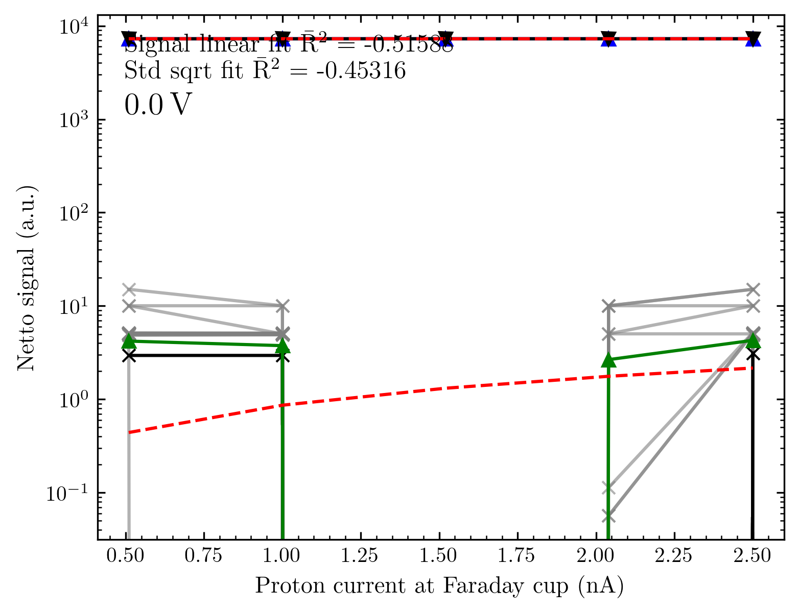
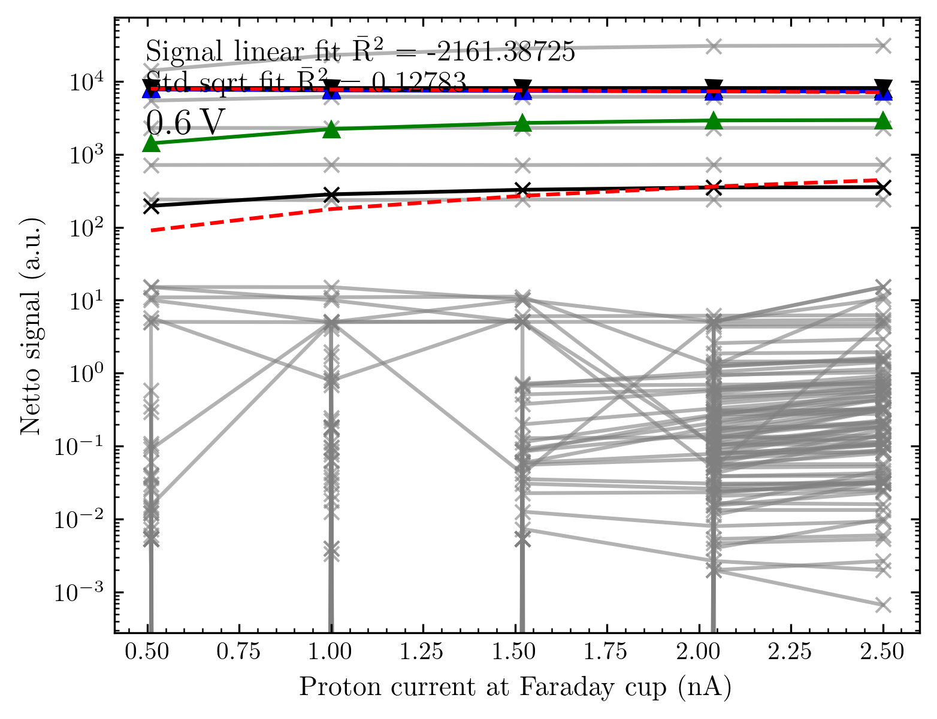
Small matrix # 1
From 0 until 0.6 V the arrays show no meaningful response as the current detected is saturated

Slide 35
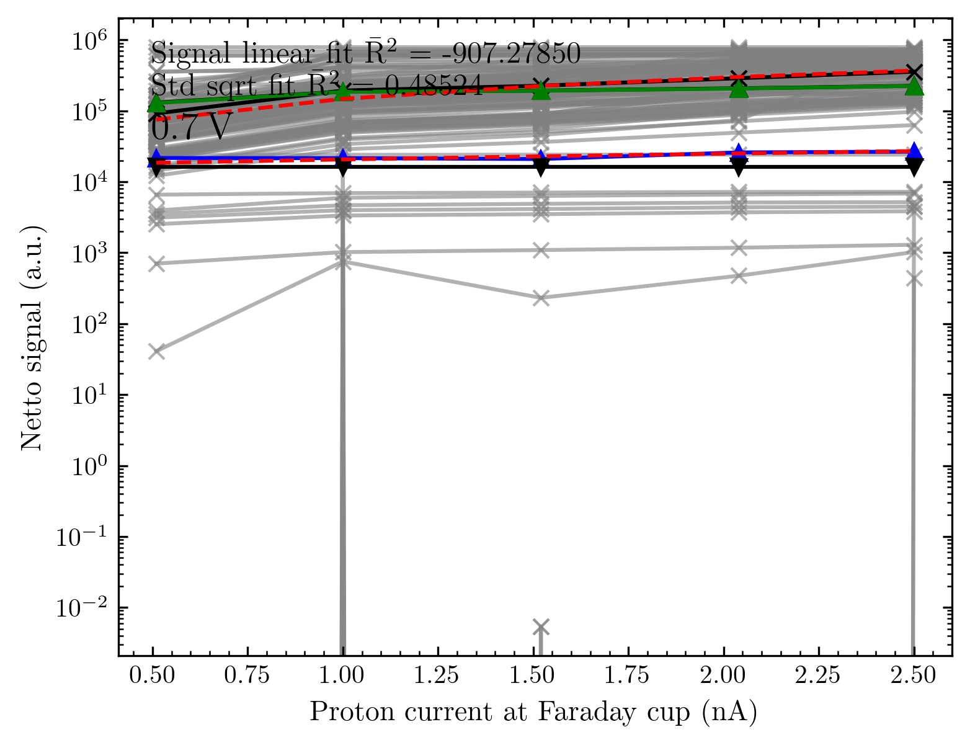
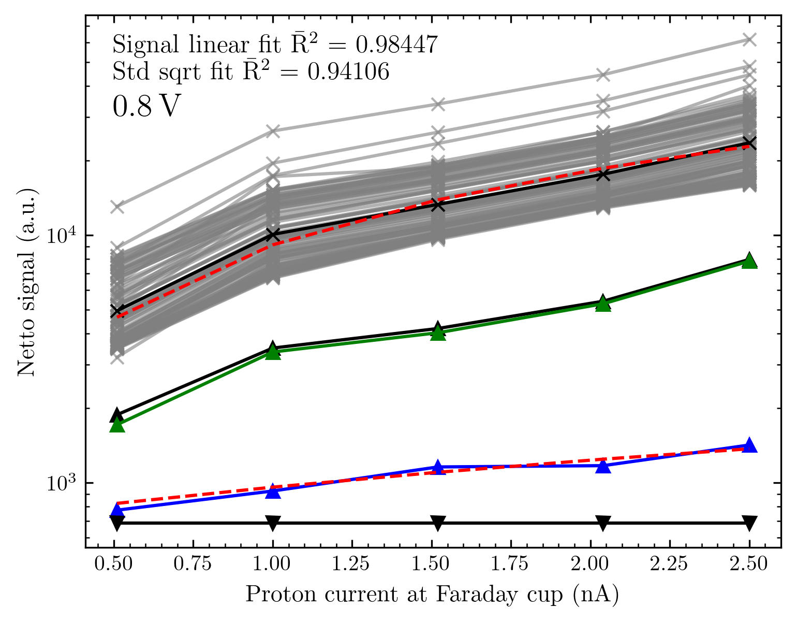
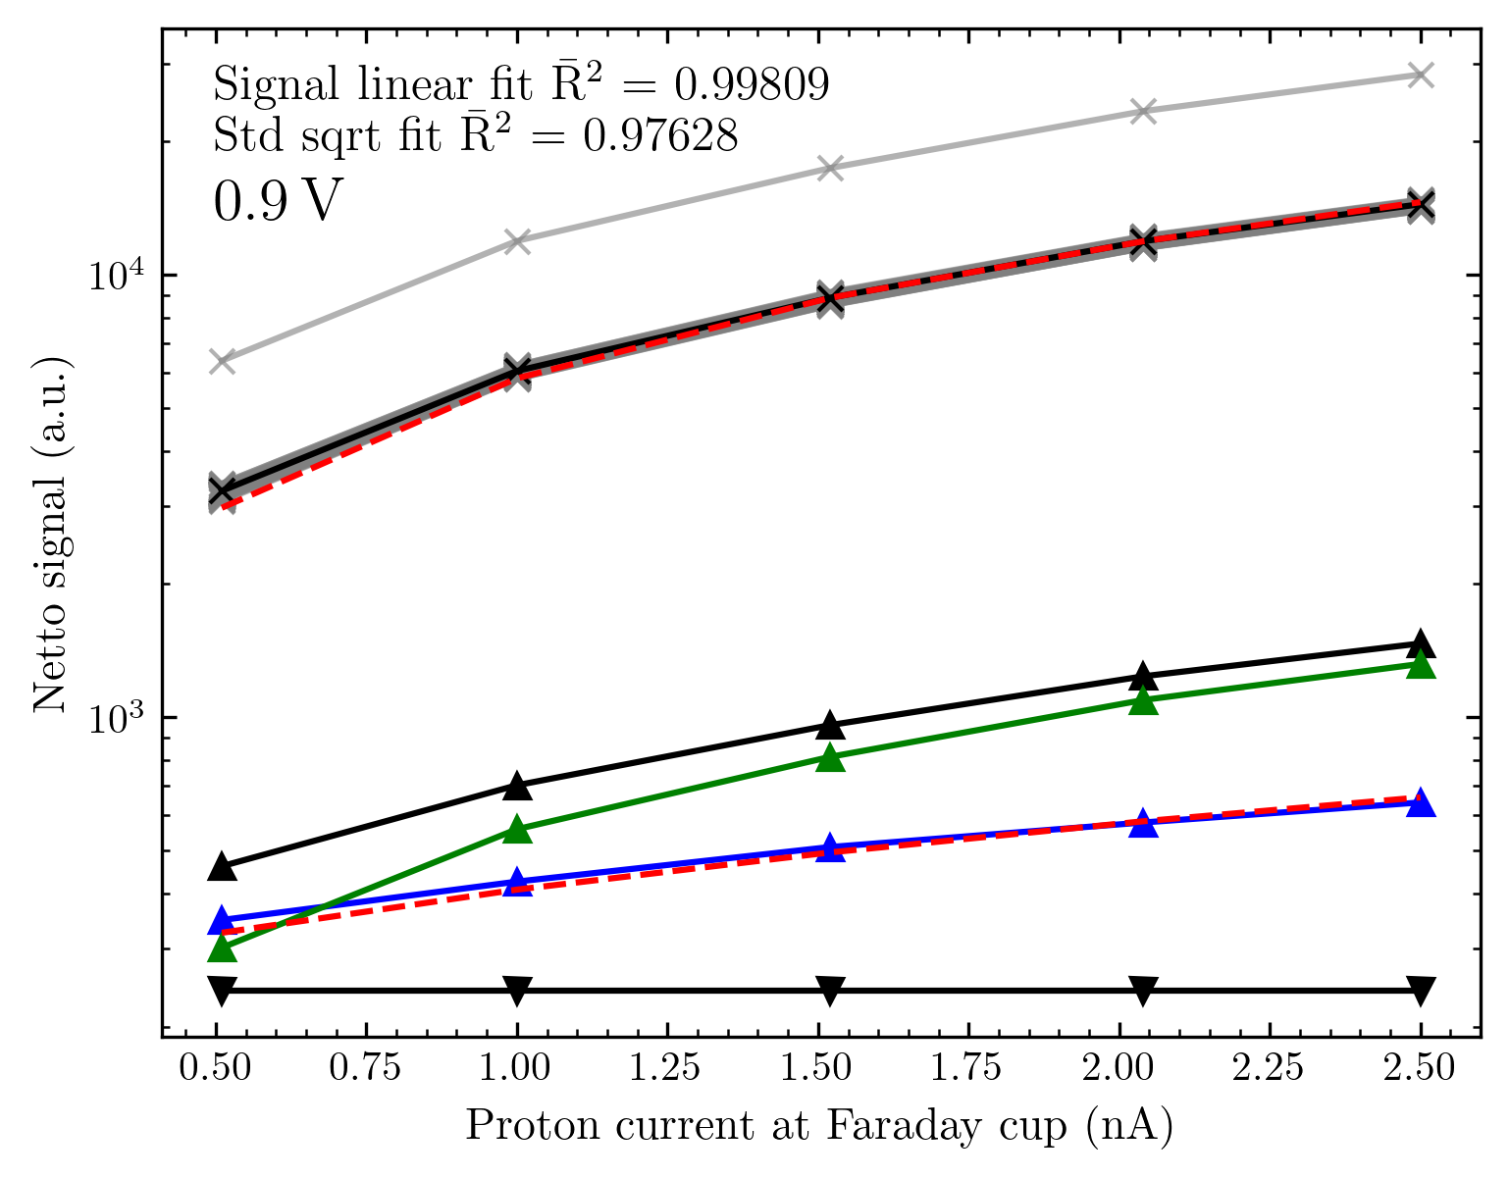
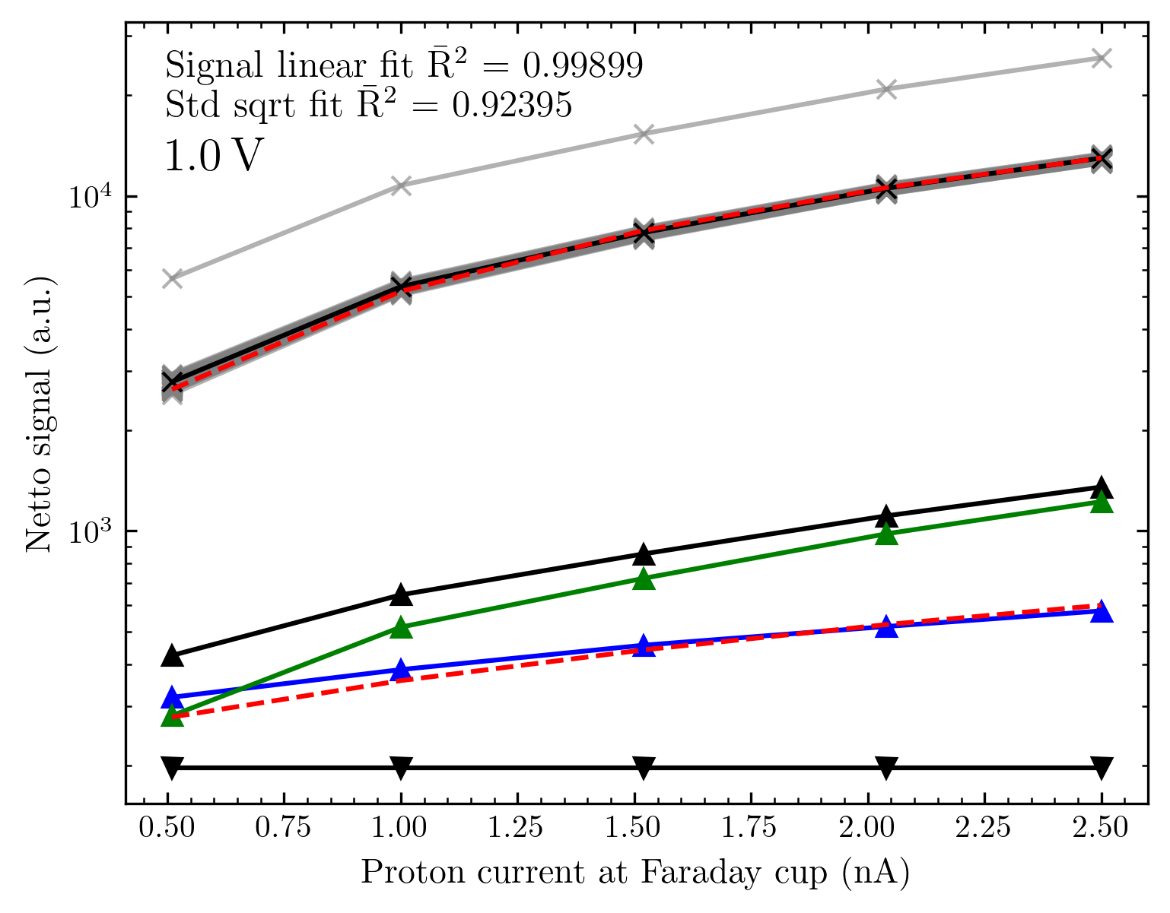
From 0.7 V we detect a real signal (as seen in voltage analysis); from 0.9 V the detected signal behaves as wanted with excellent linearity

Slide 36

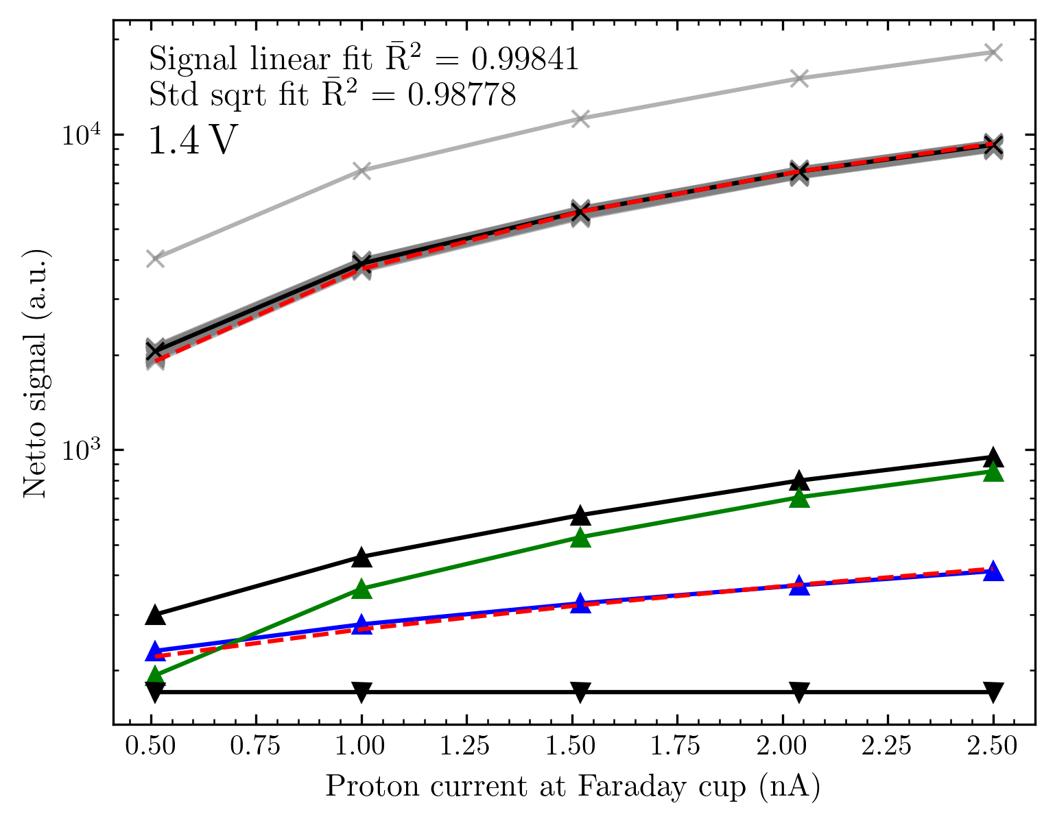
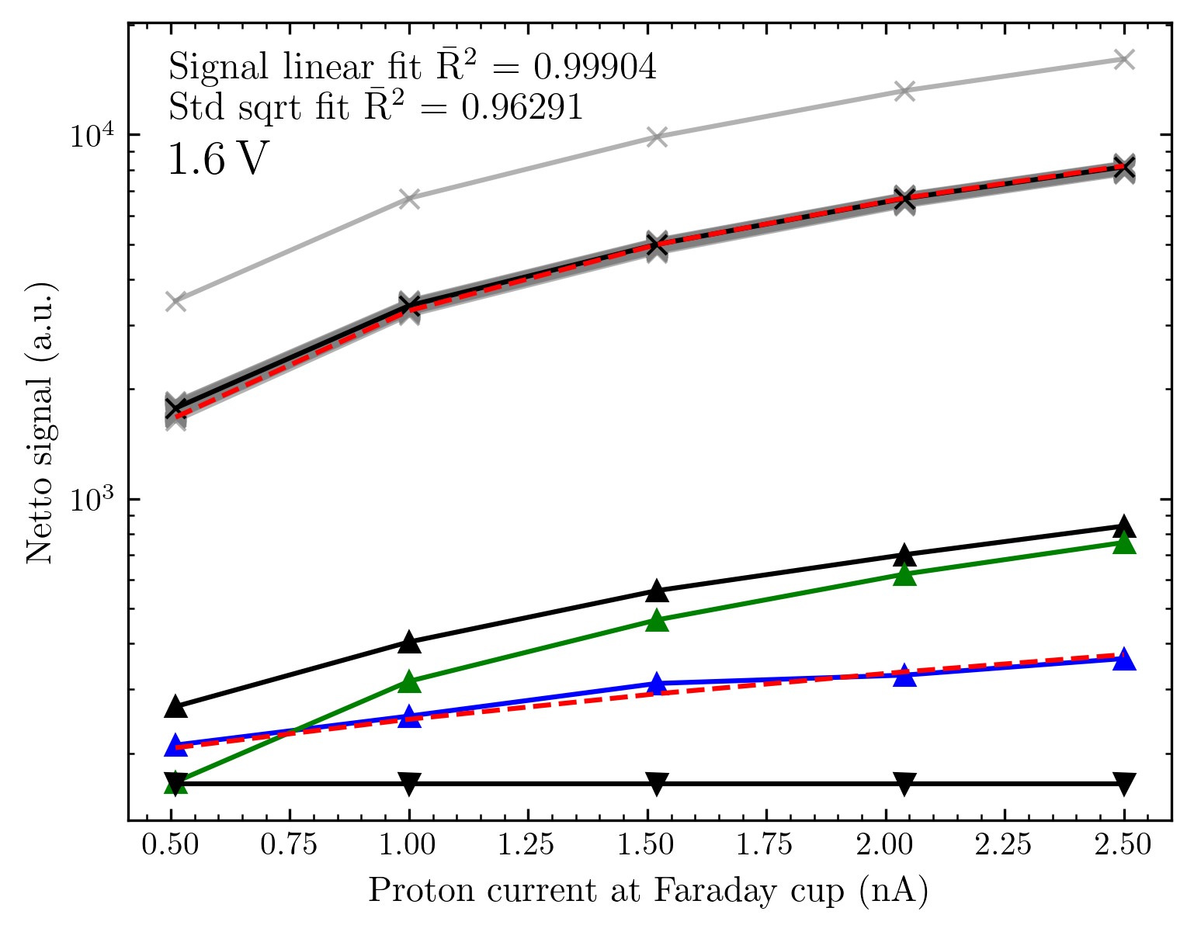
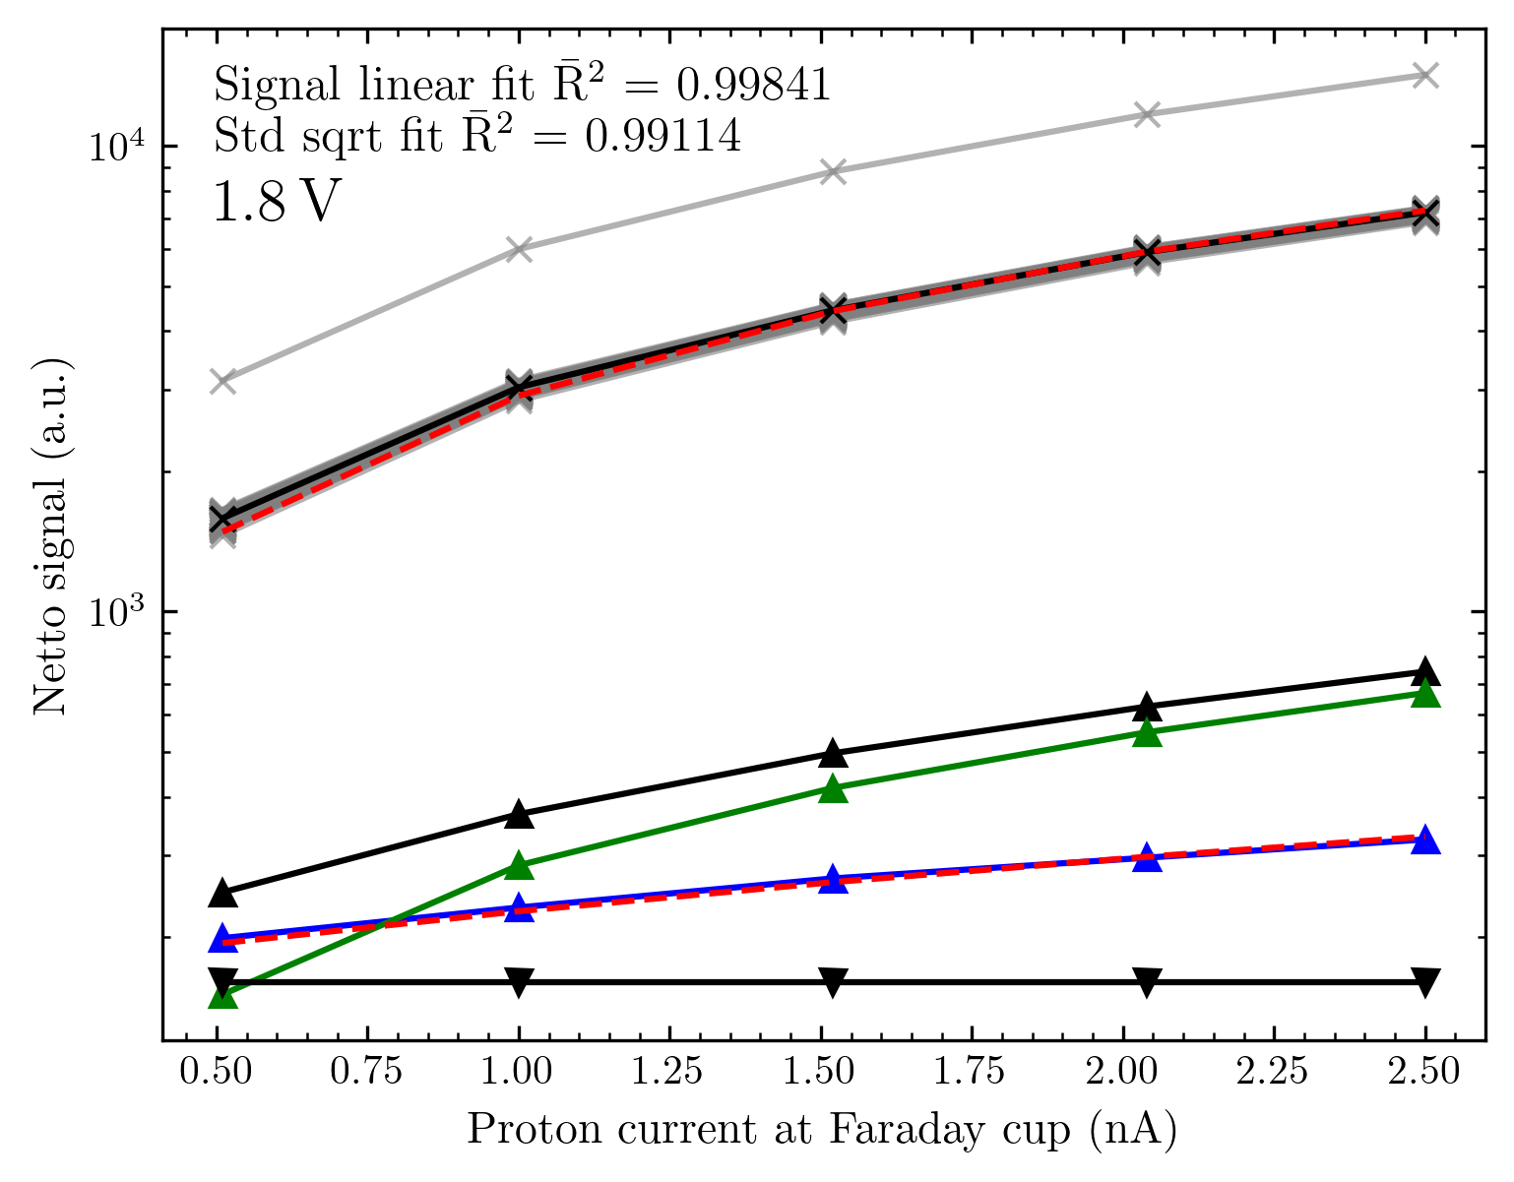
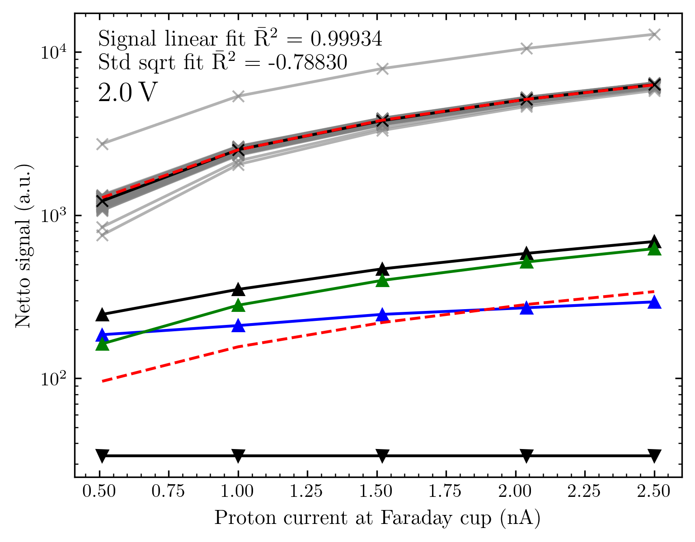

Slide 37
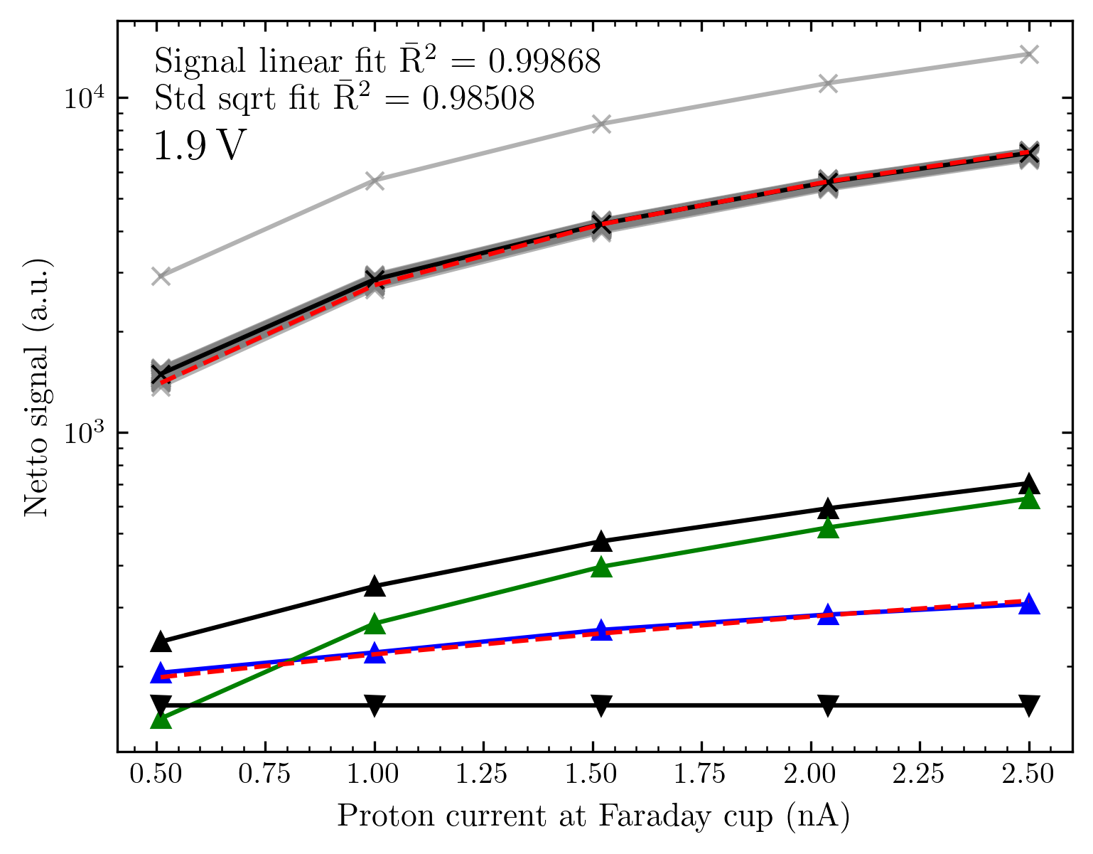
For 2 V the linearity is still excellent, but the noise becomes so small that it is not always detected. (We observe many 0‘s in the file) Thus, the signal std is not any longer growing with sqrt of the signal as we‘d expect.
This, together with the voltage analysis, serves as justification for the voltage choice of 1.9 V for nearly all measurements we did at Cyrcé since September!

Slide 38
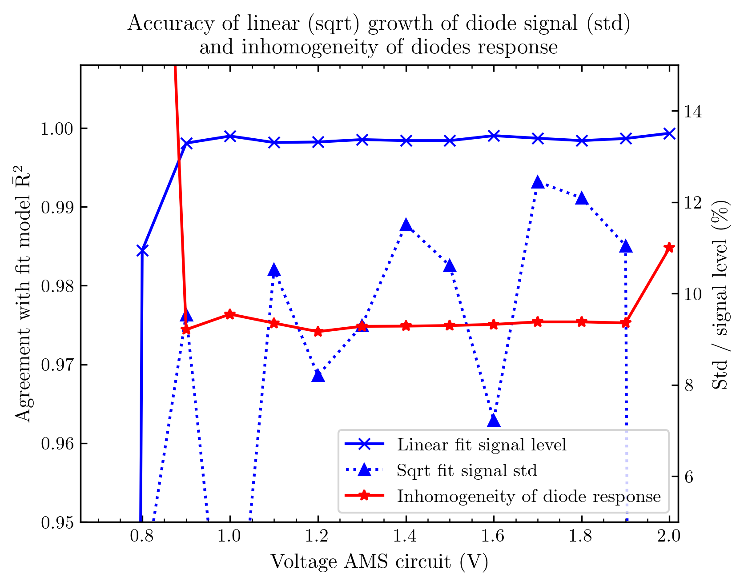
Comparison between voltages
Shown in blue is the agreement between the expected model and the real behaviour of the diode signal (signal noise).
For all voltages from 0.9 V the linearity is excellent (R² = 0.99x). There is not a real tendency observable with changing voltage.
The agreement with the sqrt growth of the signal noise is less good, but still in a decent range 0.95 – 0.99.
Shown in red is the spread of the diode‘s signal (as std of diode response/mean of diode response for each current point, and averaged)
For most voltages, this is around 9 %. (Note that the diodes are at different points in the diffused, but not totally flat, beam).

Slide 39
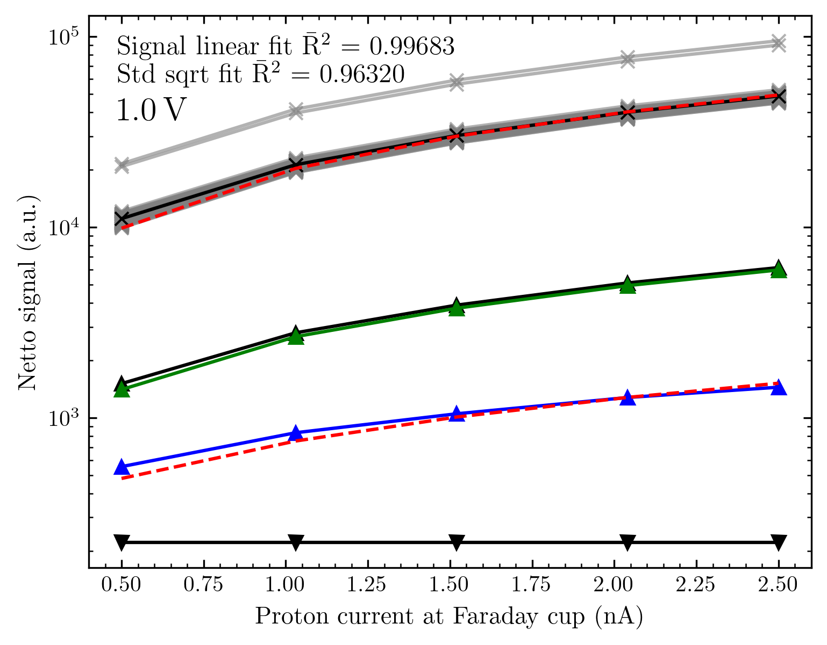
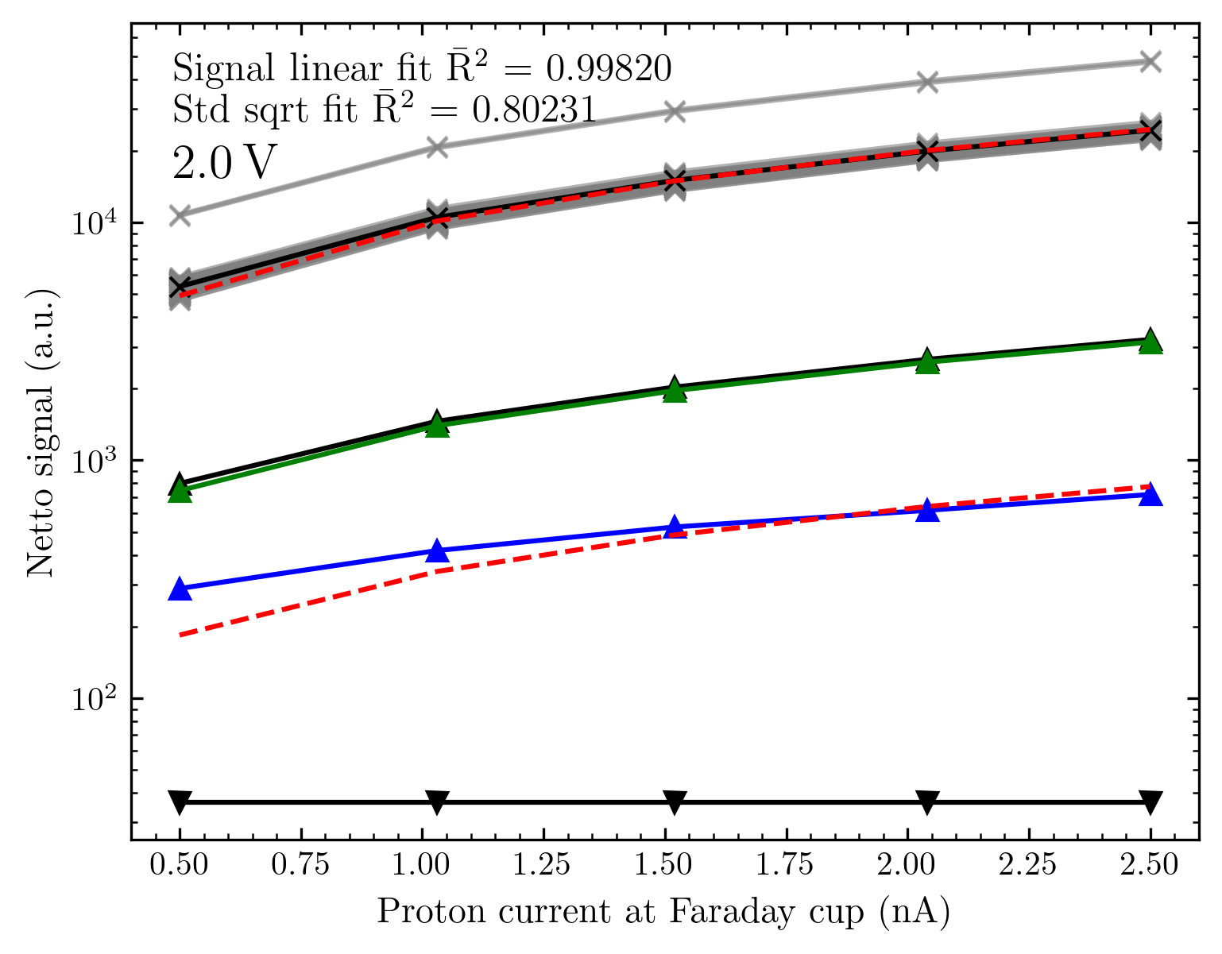
Big matrix # 2 (measurements started at 1 V)

Slide 40
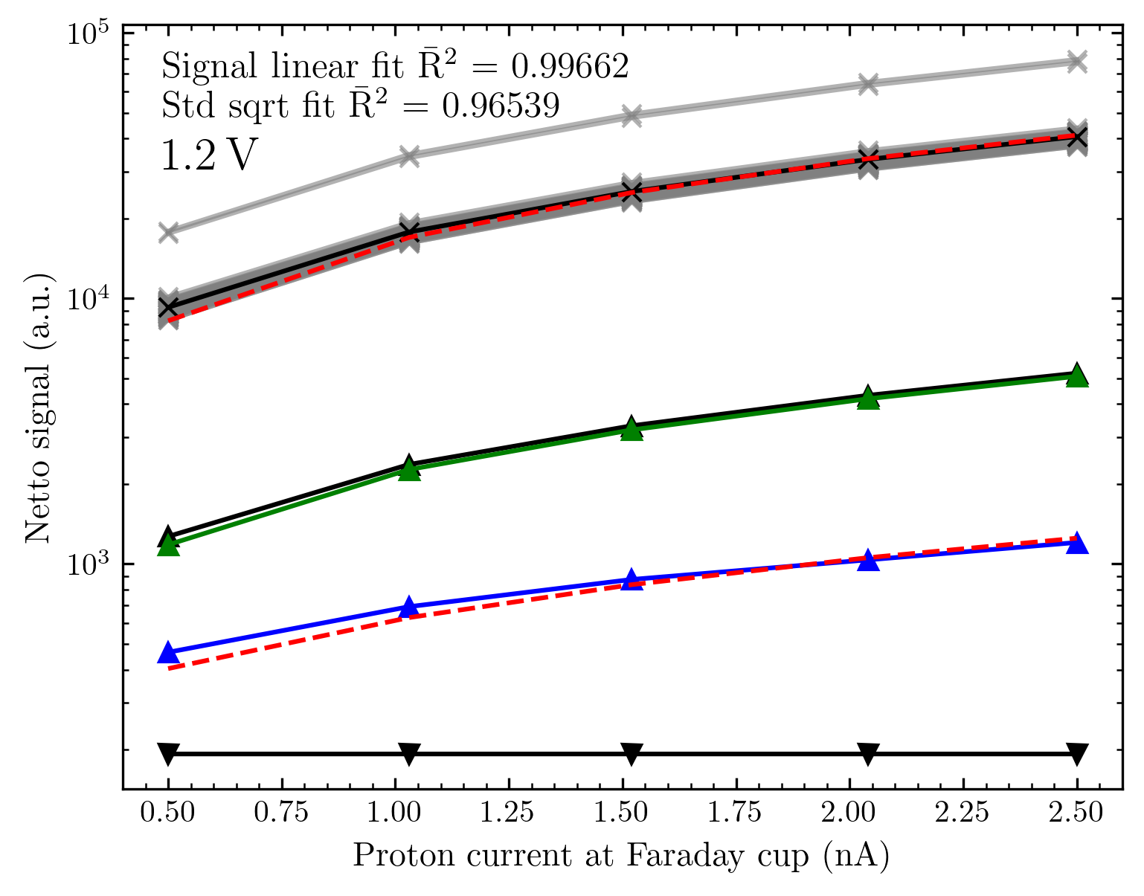
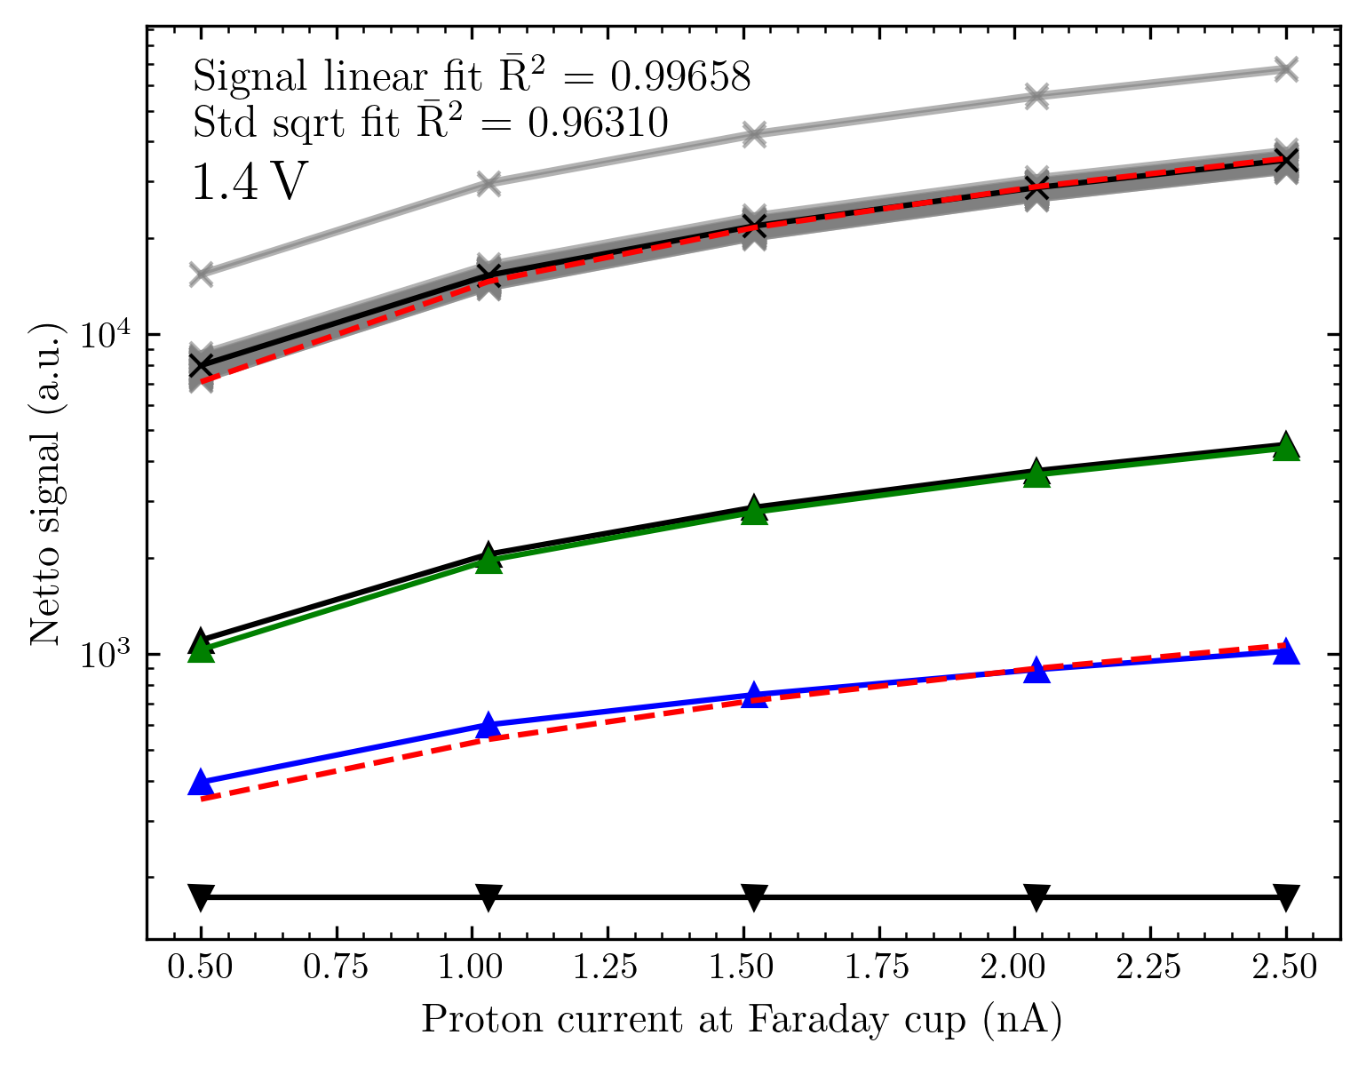
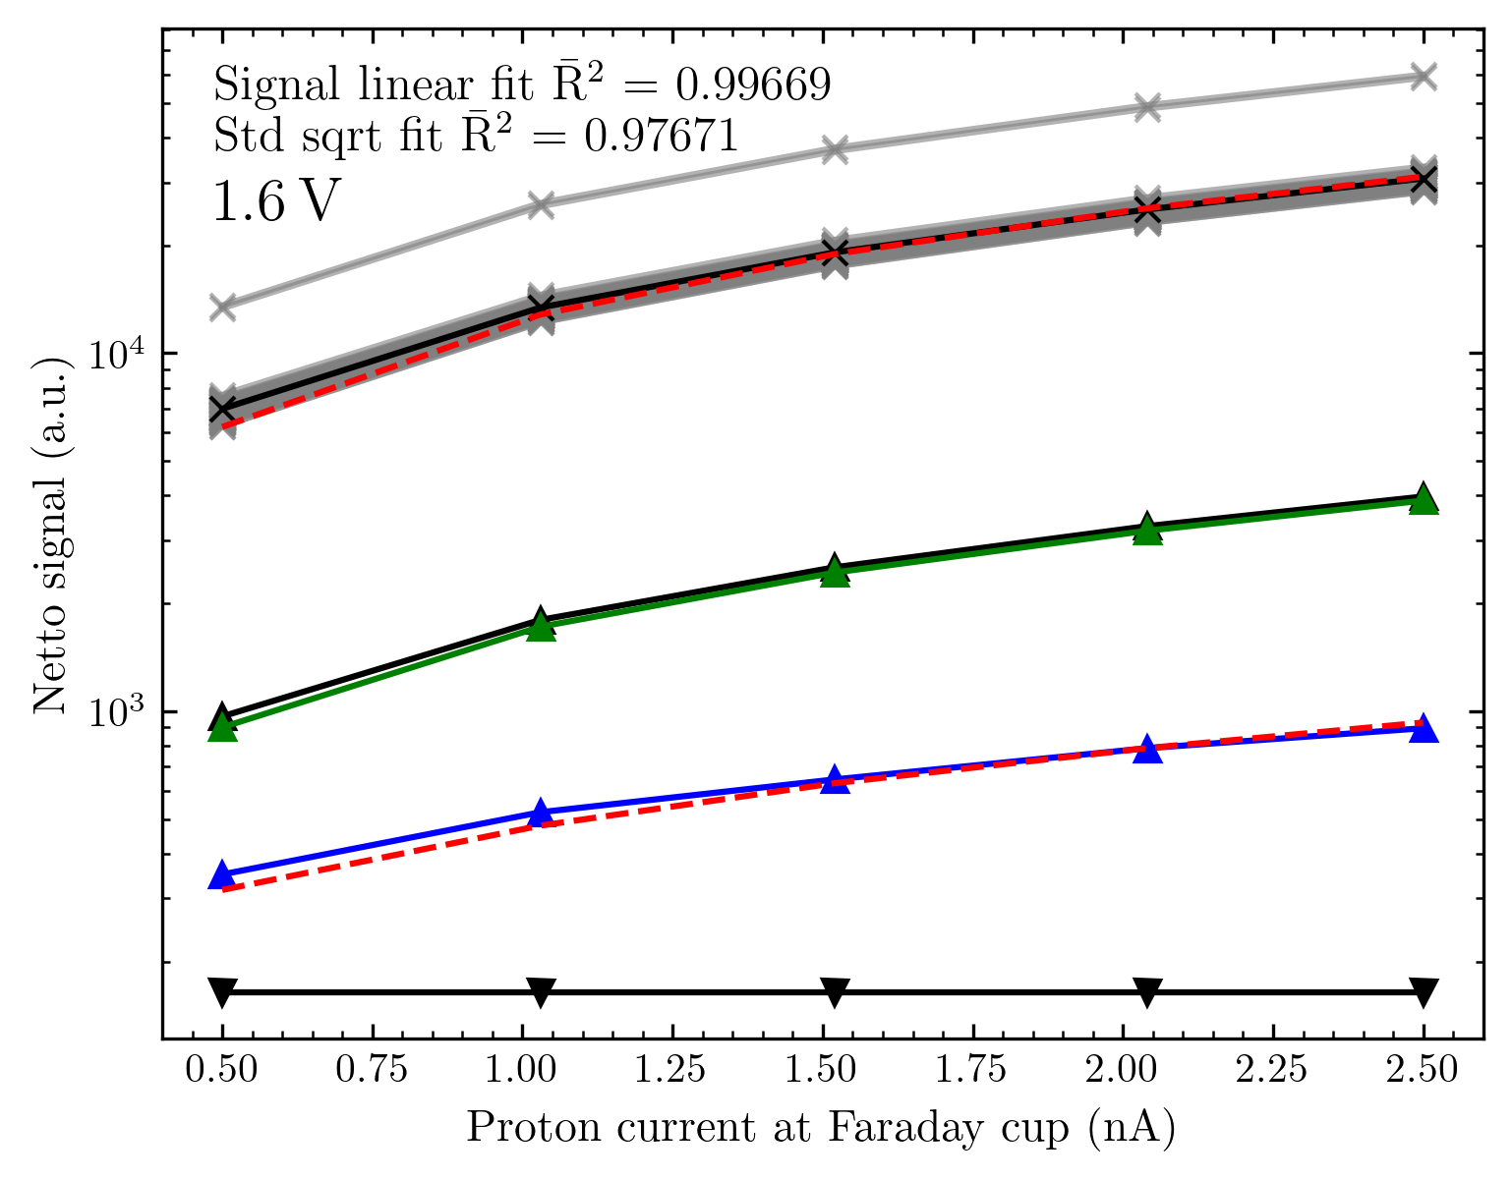
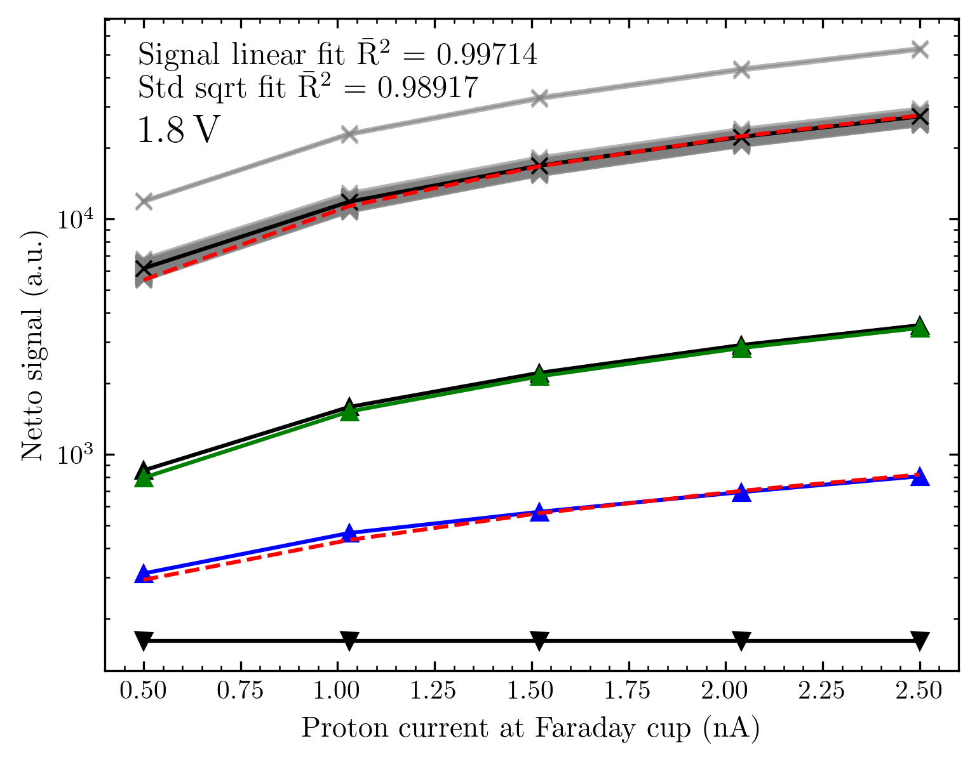

Slide 41
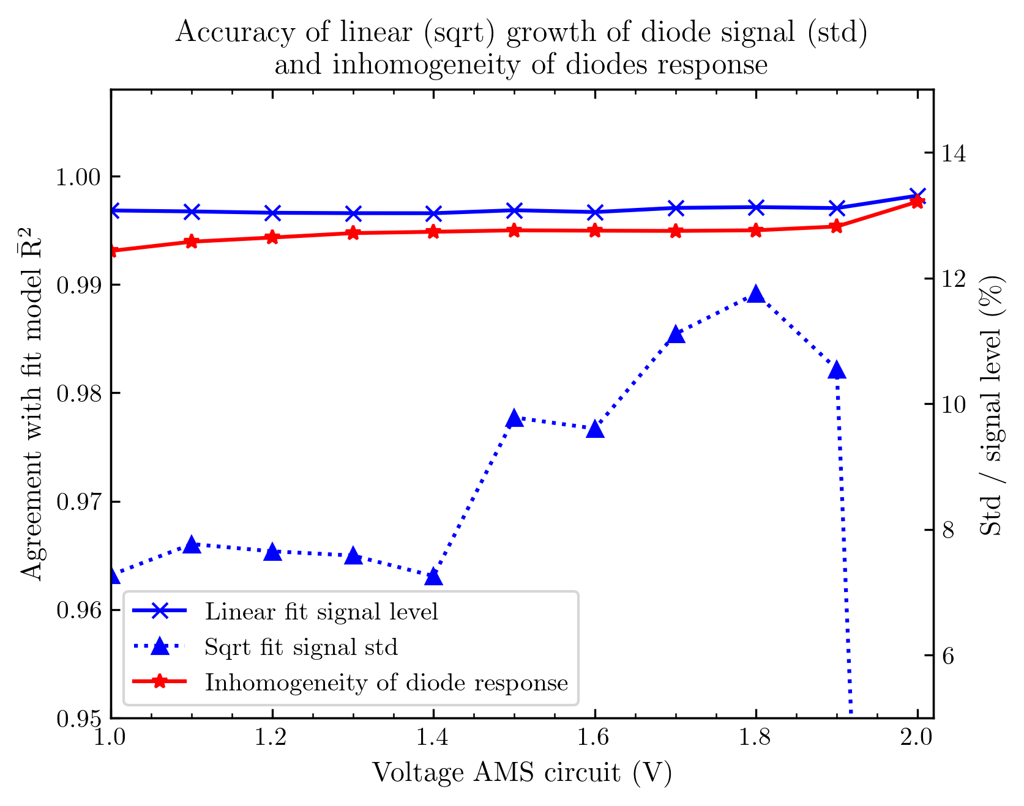
Comparison between voltages
We again observe excellent linearity for all voltages from 0.9 V (R² = 0.99x) , possibly with a slight increase for higher voltages.
The agreement with the sqrt growth of the signal noise is again less good, still in the range 0.95 – 0.99. (again except for 2 V)
The inhomogeneity in the diode‘s response is a bit higher at ~ 13 %, with a slight increase towards higher voltages. (We have bigger diodes (twice the active region) and still the diodes‘ signal might differ due to the characteristics of the diffuser.

Slide 42
Résumé
The linearity is excellent (for the small current range tested)
The signal noise is also behaving as expected
The linearity is excellent for all voltages from 0.9 V, maybe with a slight improvement towards bigger voltages.
2 V is limited in the recording of the (signal) noise
The inhomogeneity in the diodes‘ response shows no dramatic change with the voltage chosen. Except for 2 V being clearly worse than 1.9 V. (Smaller voltages could be a bit better regarding this aspect?)

Slide 43
‘2Line array‘ Results from the 2 x 64 0.5 x 0.5 mm² array
Mapping channel to diode – image creation
First results
New normalization – and results concerning homogeneity
Images
Comparisons to Gafchromic (coming soon)

Slide 44
Mapping
1
2
From the images of the array I have, I assume the bonding to be as shown:
Additionally, there will be the mapping between bonding / PCB and readout circuit.
The right image is the top view on the array, meaning in the measurements this is from the beam perspective. In the measurement, we moved the array from the beam
perspective to the left (from our view to the right)– thus, the left line of the array will be aquivalent to the line further into the moving direction.
For image generation, I will thus sort the diodes into two 64-long arrays with an offset of 0.25 mm (this option needs to be added to my Analyzer class). Because we look at the images from our view – opposite to the beam direction – the right array will contain the diodes further into a moving direction (left in the right schematic)
I will first generate two images with each line separate, then use the super-resolution available. For this, I will consider the signal of the diodes at the same position and double the number of pixels in the y-direction.
3
4
…

Slide 45
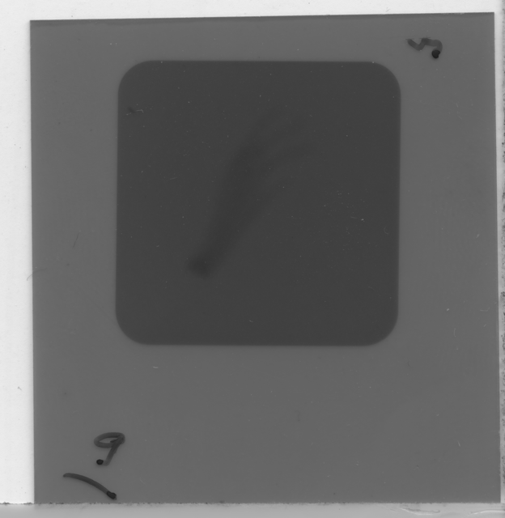
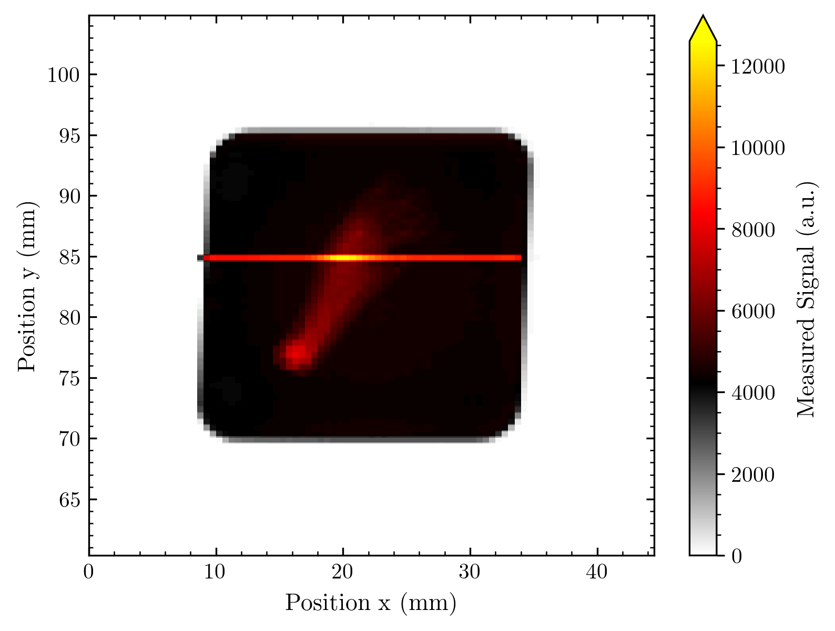
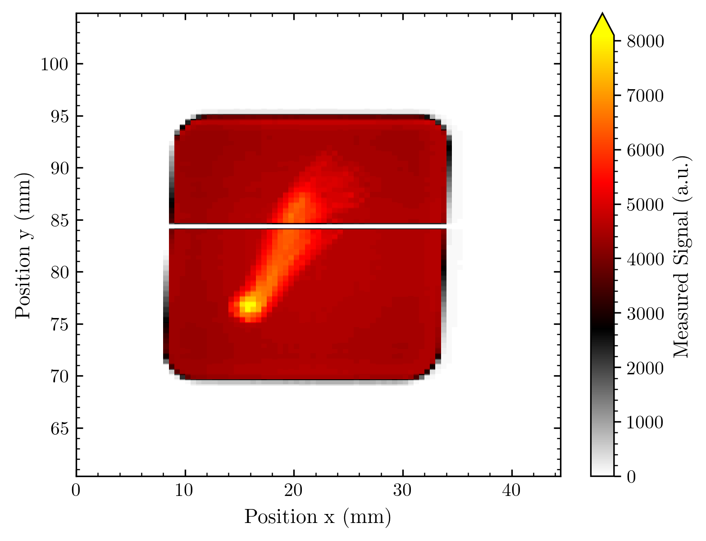
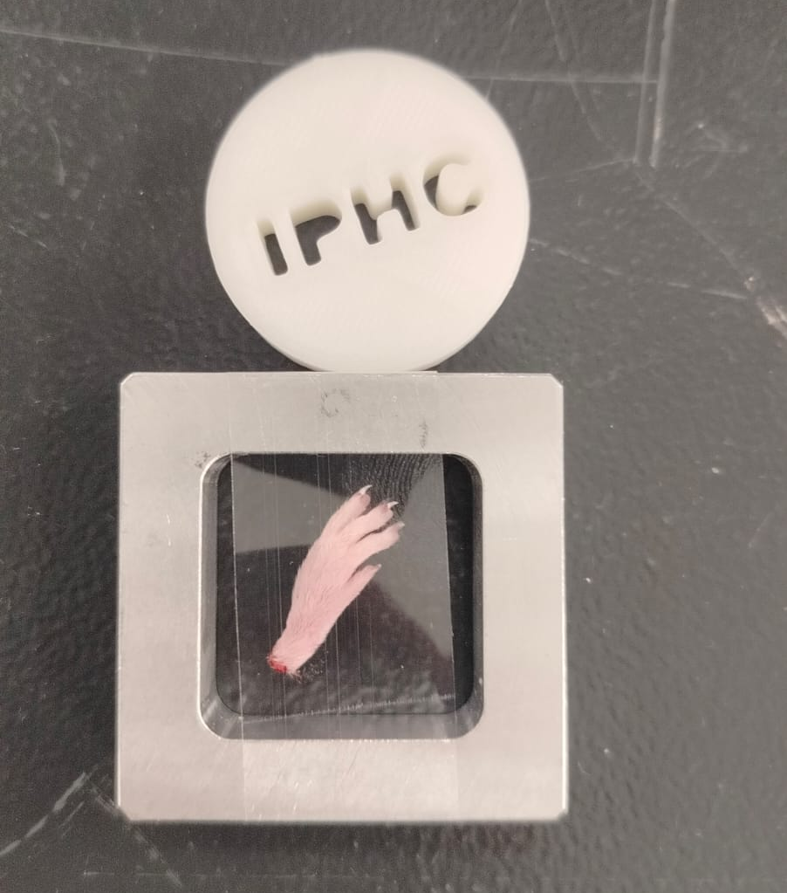
Results without super resolution
1 working but too high and one dead diode – could be from readout circuit
The resolution of the mouse foot is excellent!

Slide 46
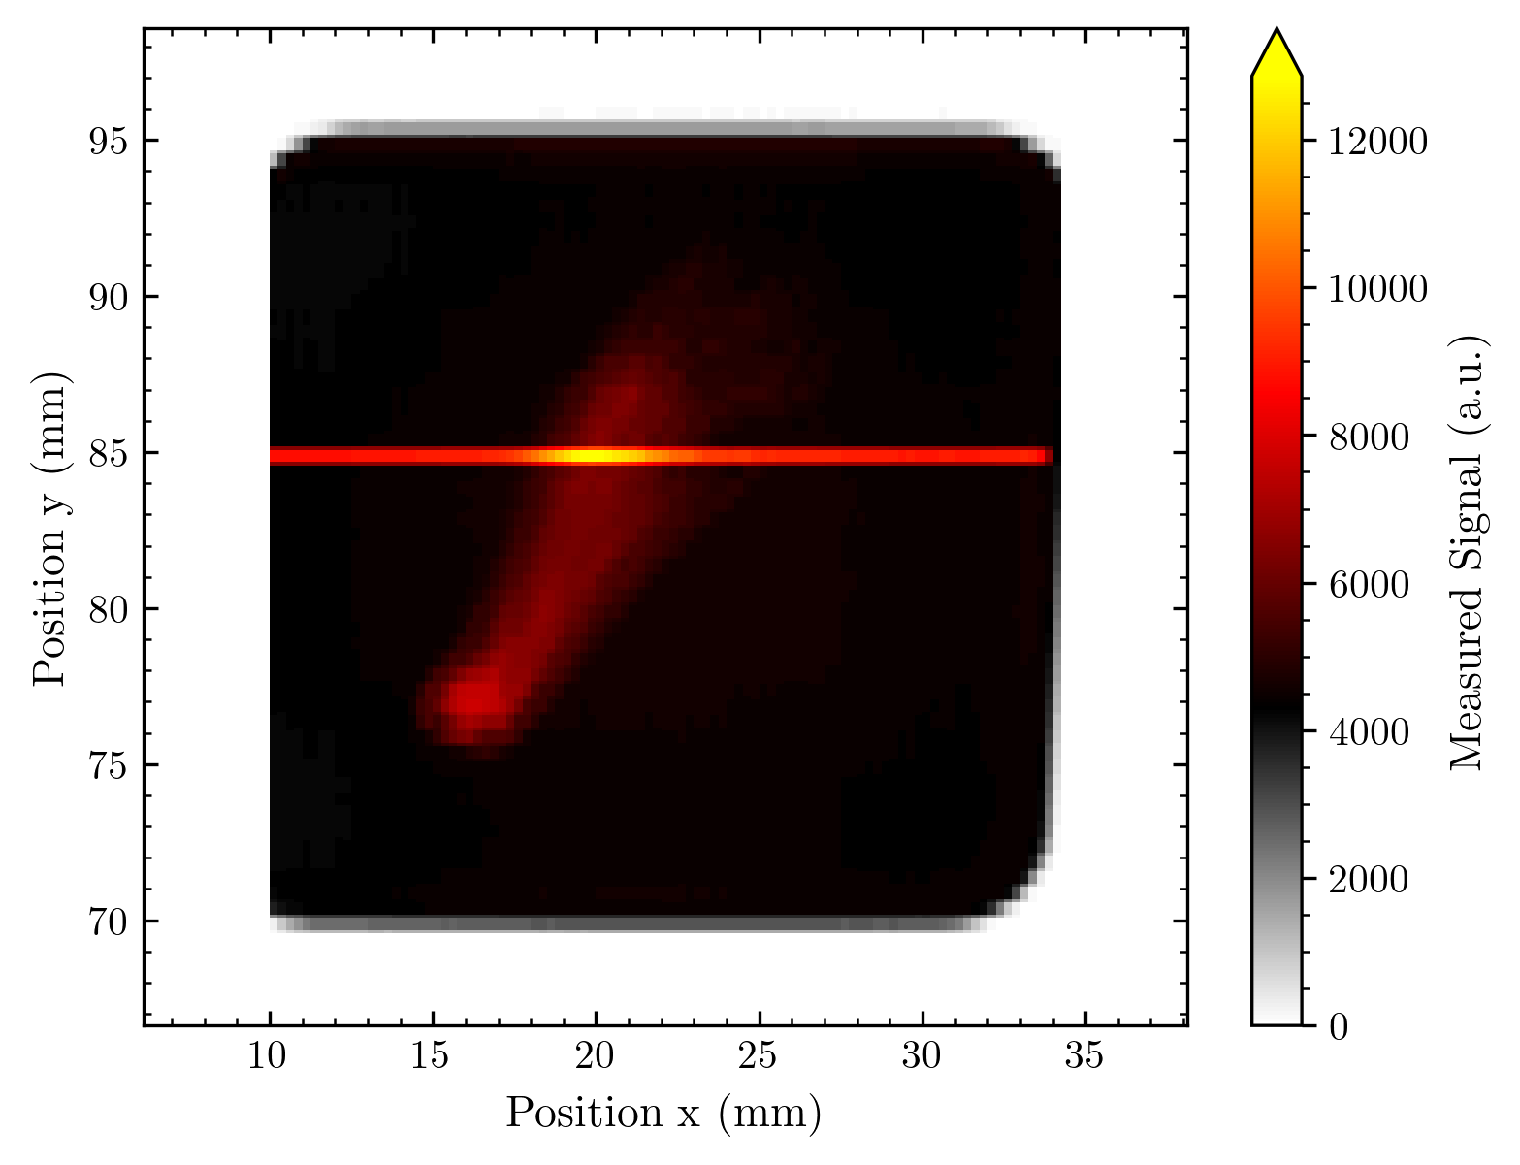
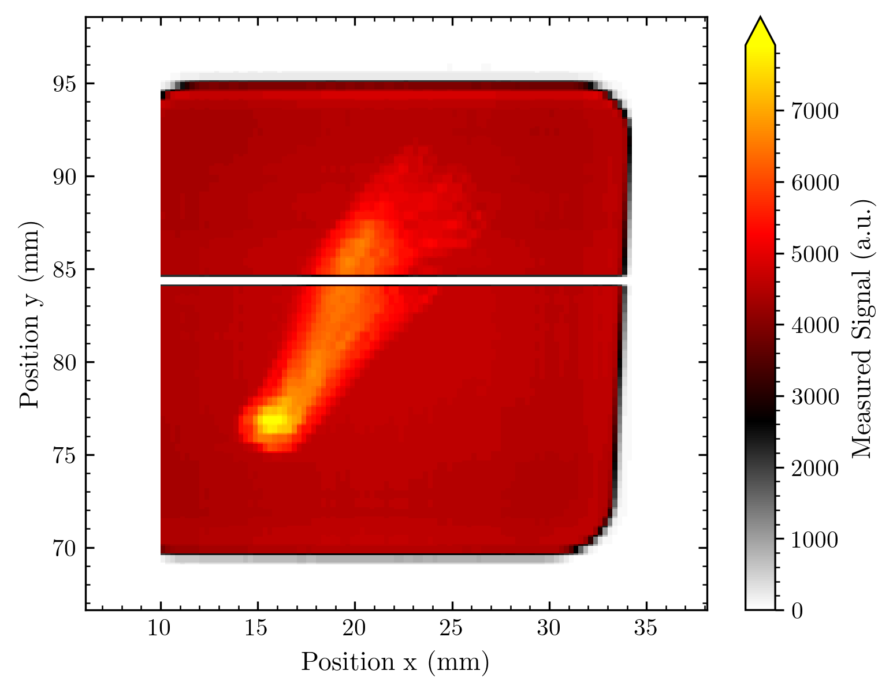
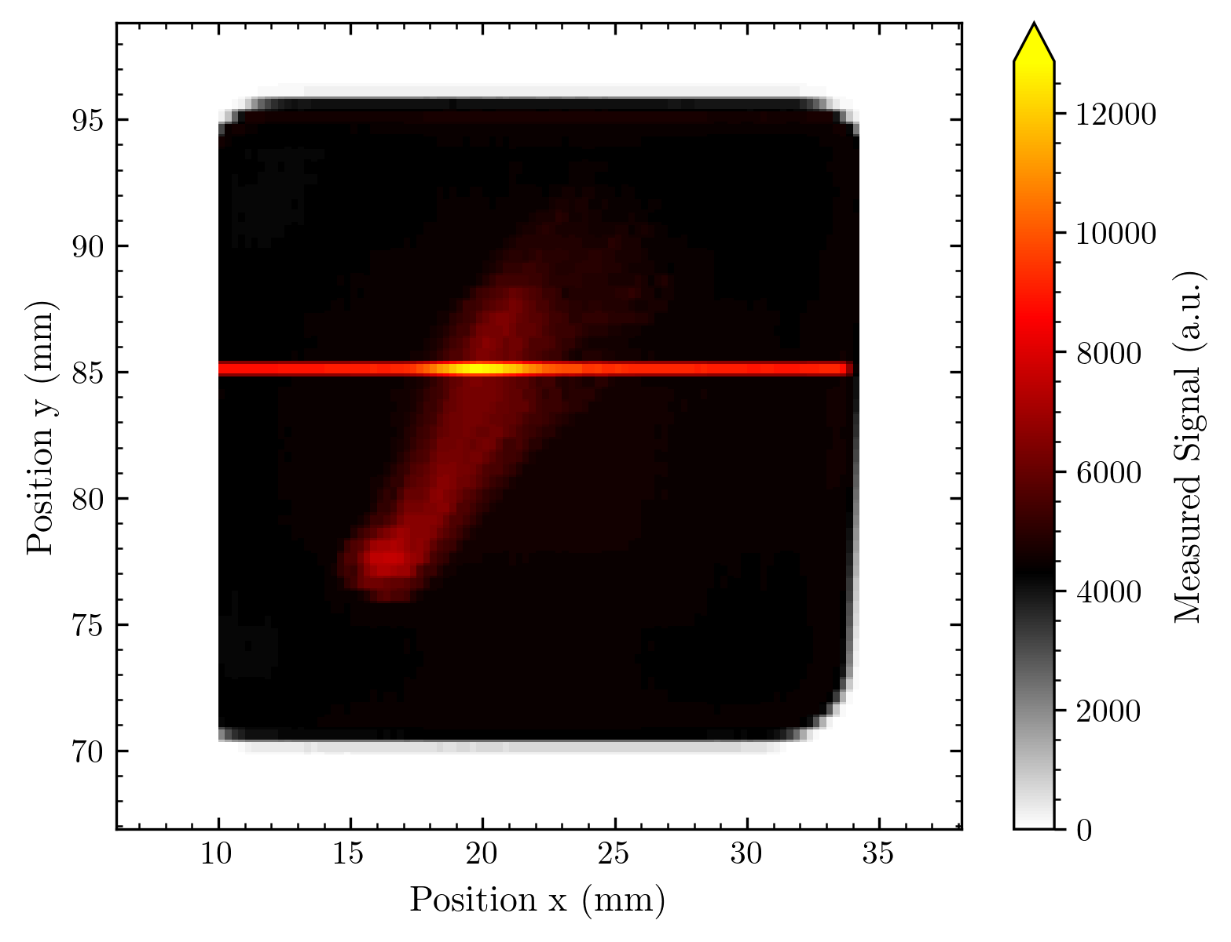

2 images 0.25 mm in y-shifted for super-resolution

Slide 47
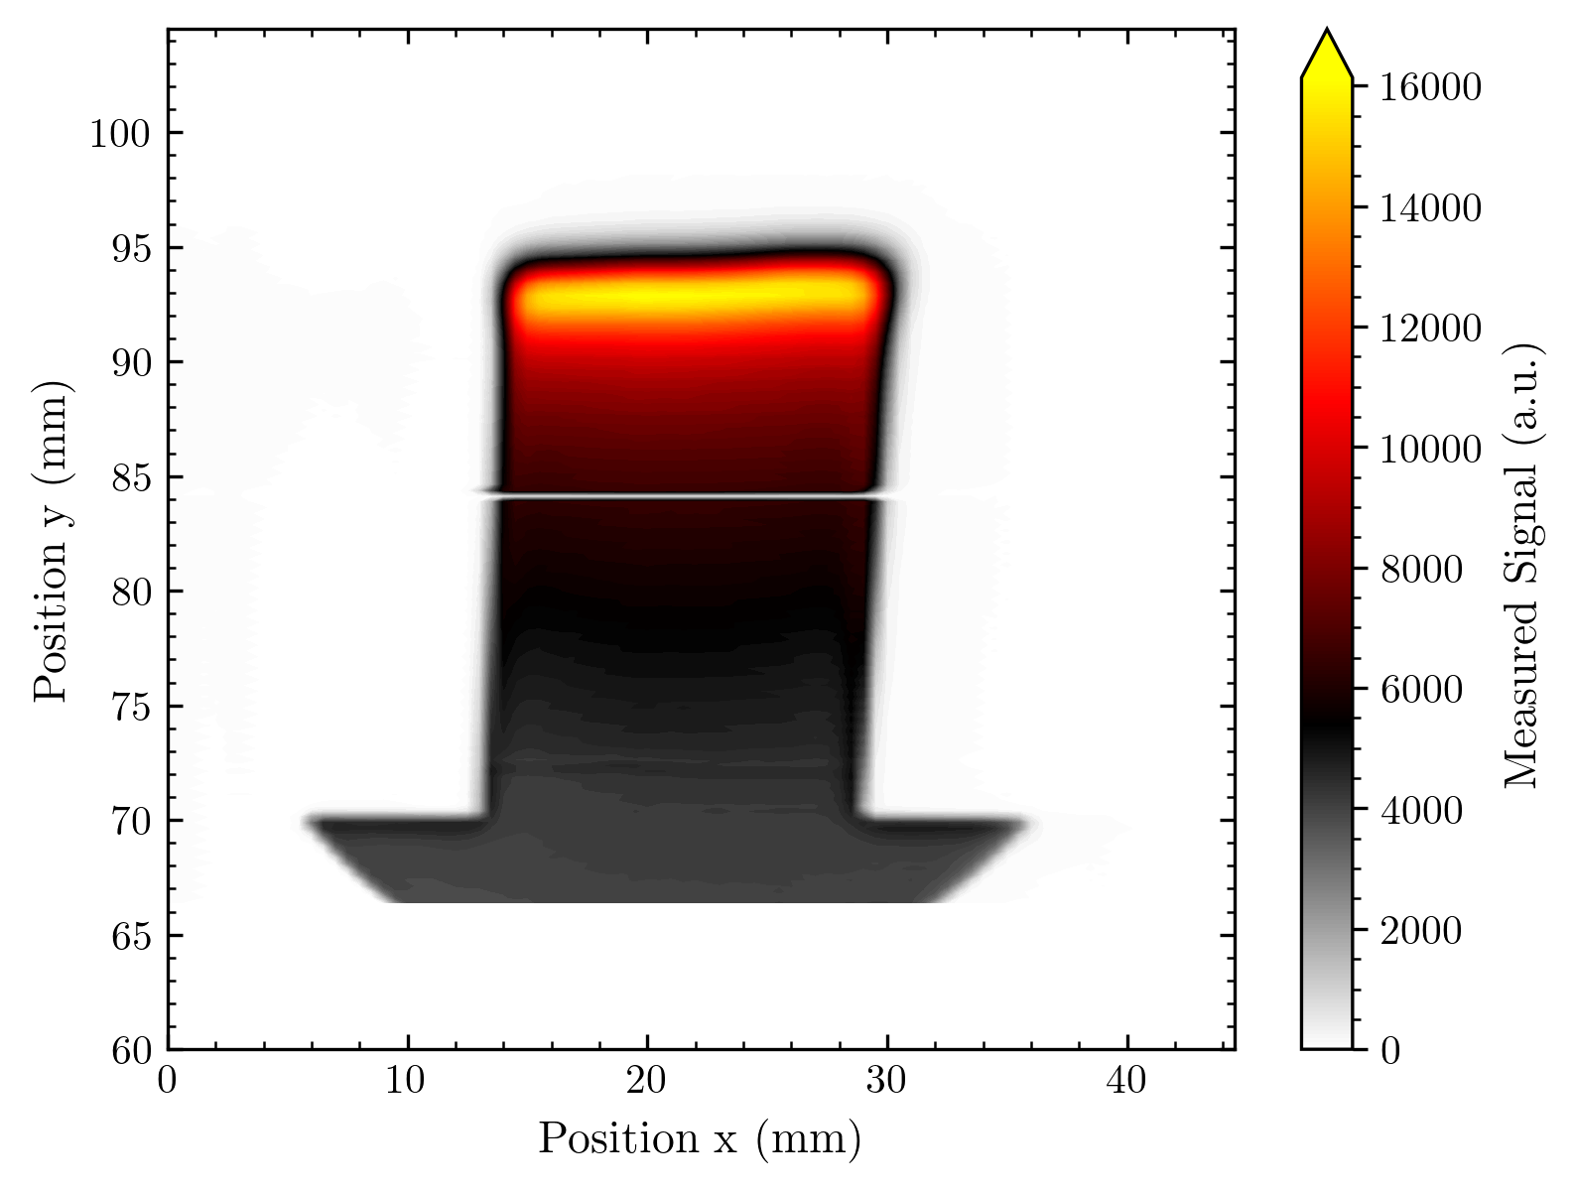
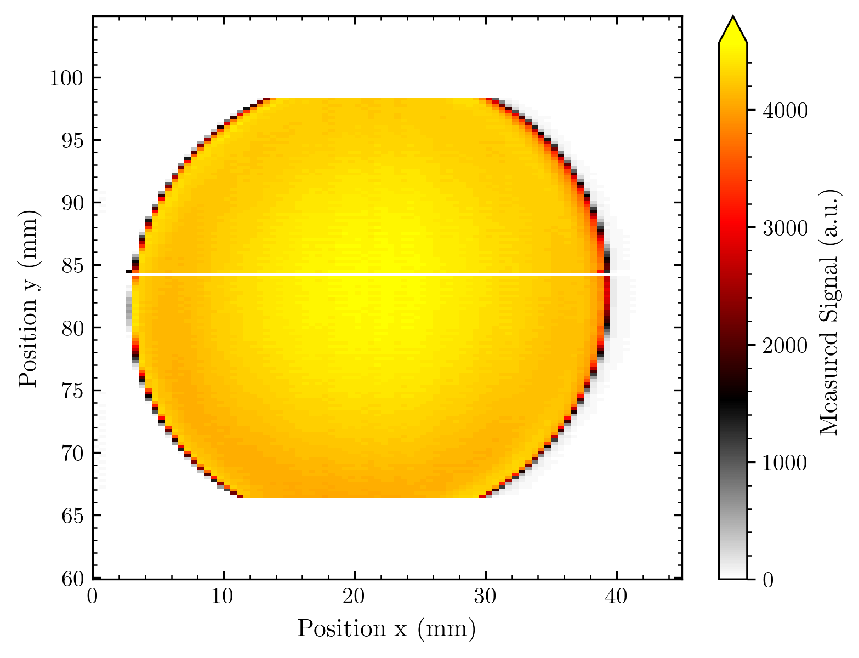
Remark: The array was tilted, thus all measurements show this slight angle.

Slide 48
New version of normalization for multi-line arrays
So far we took y-translated measurements for line arrays that extended in the y-direction (meaning all diodes were at the same positions during the measurements)
For the 2Line array and even more for our Matrix arrays, this is not the case any longer, we have multiple lines that do not necessarily overlap.
Thus, I will quickly present what I changed in the process, what could be meaningful additions for the future and what the results so far are.

Slide 49
What I added + possible problem
Diode signals are compared separately for each array line orthogonal to the direction of the normalization measurement‘s translation
From this, a factor is calculated that aligns the diodes' response to the mean of each array line
The different lines can optionally be compared among each other to align the diodes' response to one global response
This has 1 possible problem: Different lines with 1 translation mean we compare the signal at different positions in the beam. We know that the diffused Cyrcé beam is e.g. not flat, thus this adds systematic inaccuracy to the normalization.
Possible solutions:
Considering the characteristics of the diffused beam (but it requires the corresponding knowledge, and the best reference we have are probably our measurements)
Add complexity to the standard normalization: X and Y translation to have multiple overlapping positions for all diodes
Live with some inaccuracy in the calibration under the assumption that the important correction comes from the ‘high frequency ‘ fluctuation in the factor; and the low frequency component that is affected might be removed anyway

Slide 50
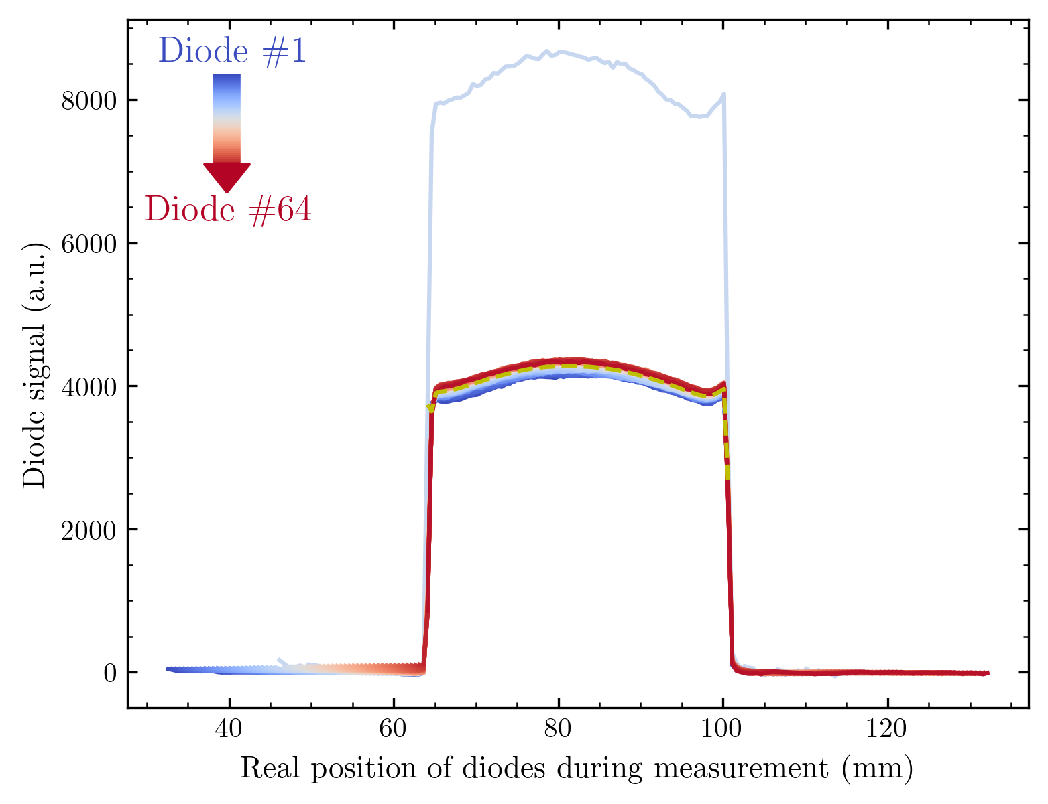
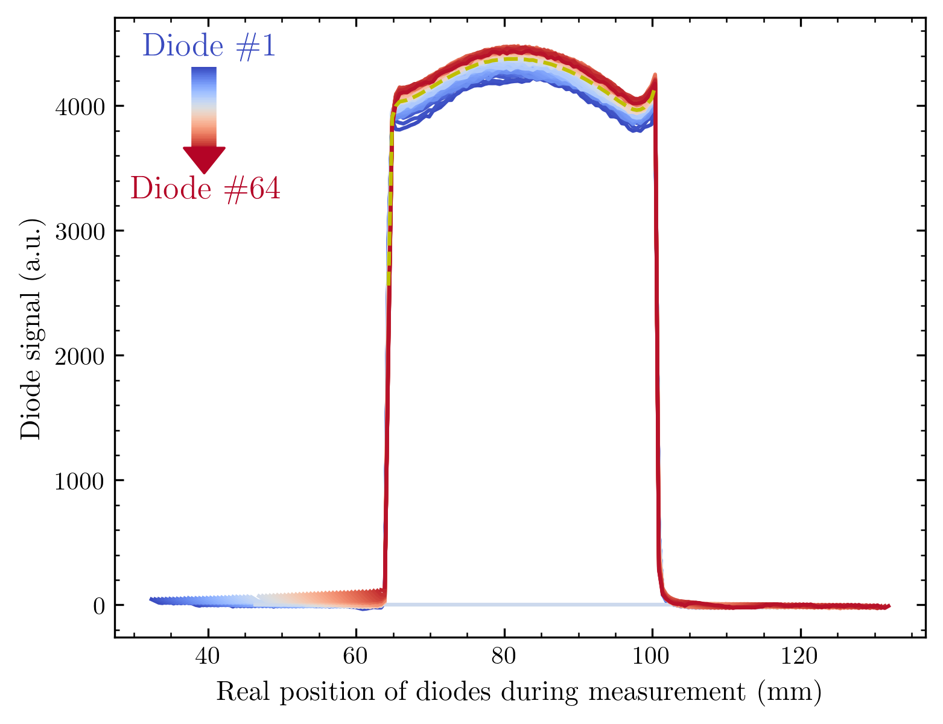
Result 2Line
Line 1
Line 2
We have 2 lines in the x-direction and a translation in the y-direction for the normalization; meaning 2 lines I apply the well-known procedure on.

Slide 51
Another addition
So far I only consider signals over a threshold to ignore channels not working.
Now, the one high-signal channel requires another addition: I need to add an upper limit to ignore these high signal channels. (Otherwise, the mean is affected and all other diodes' response is corrected to a higher-than-normal value.)
From the fluctuation between a few % response we had recently, I assume the following border to be more than conservative enough to not affect the results:
For mean considered diode =
threshold (Otsu‘s method) < signal < 1.5 * mean over threshold

Slide 52
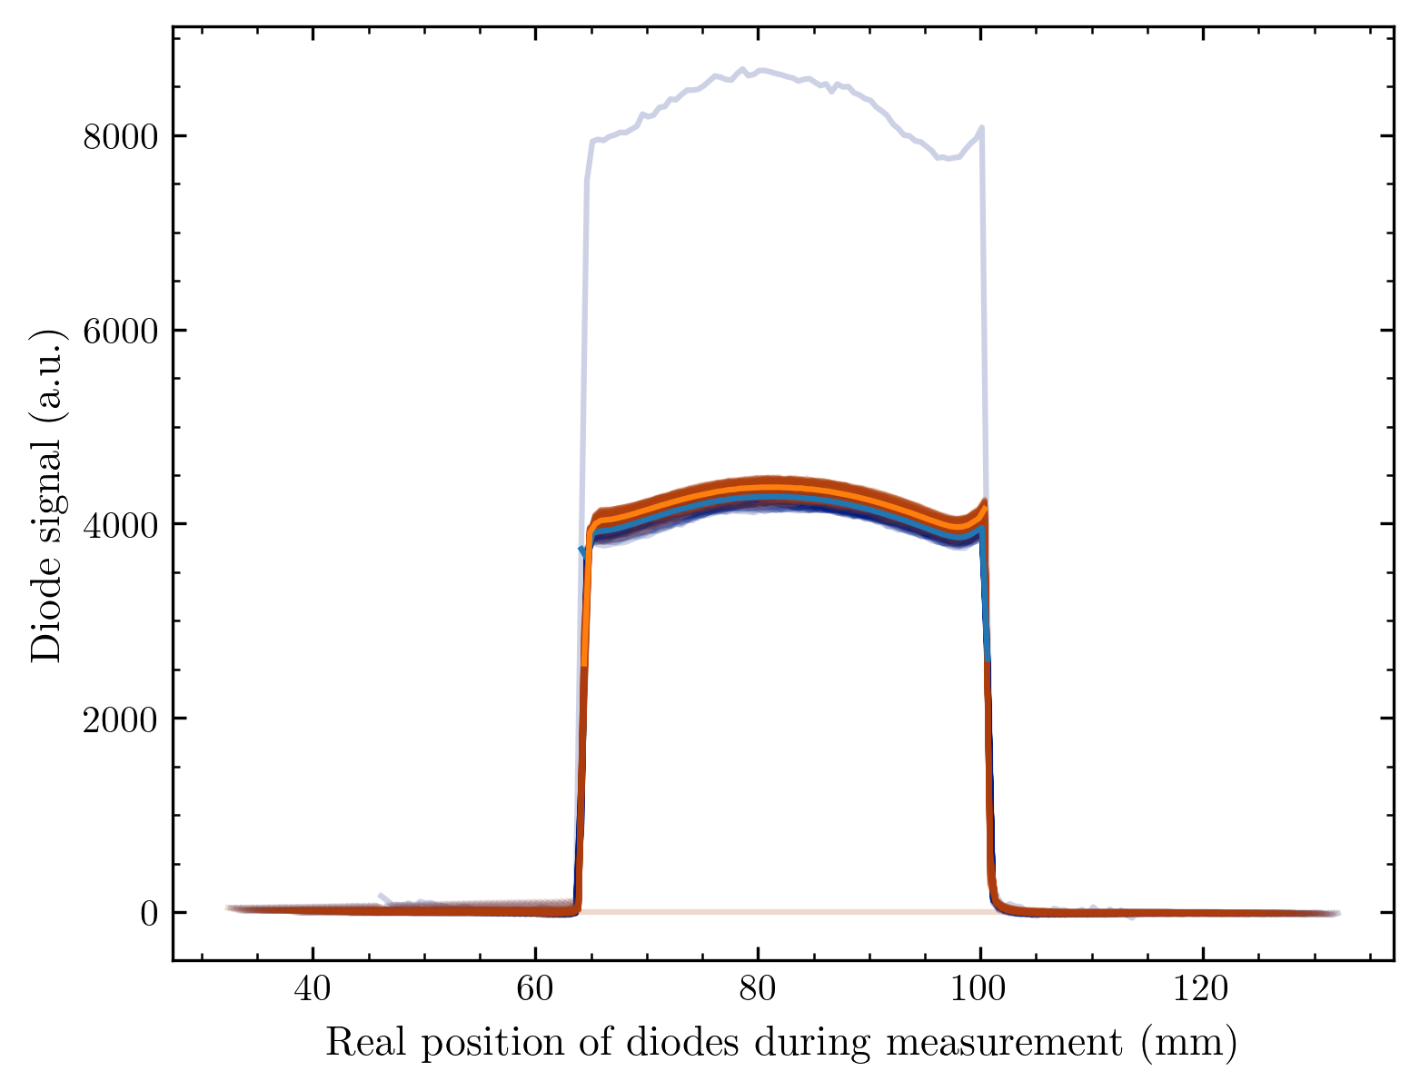

The 2 lines compared
There seems to be a difference in the mean signal between the two lines of the array! (Note that the beam instability with time
reflects in a larger spread within one line – not in the difference between two lines (the lines come ~ at the same time into the beam)

Slide 53


Factor for each line individually
The high signal channel has a factor of ~ 0.5 while the neighbour channel not working is always exactly 0…
The high - frequency fluctuation is again really small, but we register some baseline underneath – likely from beam instability

Slide 54

Comparison to global alignment
There would be some discrepancy (~ 4 %) in the response between the lines, if I align them to their global mean.
If this is the case, there seems to be a systematic difference between the two lines (I will consider this for the images).
Aligning the two lines to their global position mean is reasonable here since the difference of the 200 um diffuser on the length scale 0.5 mm will be below these few percent differences.
Anyway, let's keep this in mind for the images before and after normalization!

Slide 55
Some words to the factor
Underneath the individual differences among the channels (high frequency) is clearly a baseline lowering for the diodes with high numbers (low frequency).
Since this pattern is probably exactly the same for both array lines, and the diode number corresponds to a different time coming/leaving the beam, we very likely observe the instability of the beam.
This is one the scale of ~ 5 % between begin and end of the measurement; I noted the following two currents at the Faraday cup:
2 nA at the begin and 1.8 nA at the end.
This means a decrease of 10 %, which is very well in the range of the fluctuation we observe here (considering that each diode remains some time in the beam and we only partially correct for the offset on the whole time of the measurement)

Slide 56
Résumé
The pattern underneath the factor needs to be removed since it adds a stain to the data that does not exist in reality!
From the multi-line measurements, I can develop a sophisticated method applicable to the single-line measurements.
I will do this in the next few days since this will be important for judging the fluctuation in our response (which is quite an important value).
Words on the process I intend to use (I have quite some experience with fitting a baseline to data:
I will try to use a very restricted model to be sure I do not remove any pattern coming from response differences between the diodes. (Probably a 2D polynomial or a Gaussian – if there is some reasonable assumption for this to be the beam decay pattern)
Since I have the same pattern under 2 different data sets (or under 11 for the Matrix arrays!) I can judge which method could be the best suited here.

Slide 57
Images 2Line array
Individual lines vs. two lines (so far no deconvoluted super-resolution)
Before/after normalization (so far stained by beam power decay)
Removing the single non-signal line
Overview of all images made

Slide 58



40 um diffuser / round aperture
I consider the offset between the two lines and assign a position to each pixel
So far this results in pixels with 0.2

Slide 59
ToDos (I‘ll try to get as much as possible for next Tuesday)
Remove the low-frequency component of the normalization factor
Method development
Normalization for all arrays (including matrices) + redo image generation
new judging on response homogeneity
Updates on image creation:
Super-resolution (by known deconvolution into 2N imaginary pixels)
Creating pixel images with equally sized pixels
Comparisons with Gafchromic Scans
Energy-dependent measurements (PEEK wedge, image quality)
Making the movies fancier

Slide 60
Update on image creation
An overlap between pixels should be recognized and used to create a super-resolution
If there is an overlap in both directions the 2nd super-res has to be calculated out of the 1st one
Overlap = Diode spacing becomes irrelevant for image generation in this direction (overlap is considered if it is larger than the diode ground spacing)
If no super-res is calculated, the oversampling should be treated the following:
Split the array into single pixels (where each pixel is taking the same amount of space around the middle of its origin) and thus ignore the overlap

